Slide 1
Artificial Intelligence DR.Abeer Amer

Slide 2


Outline
Blind vs. Heuristic Strategies
Blind Strategies
Depth-First Strategy
Depth-Limited Strategy
Iterative-Deepening Strategy
Breadth-First Strategy
Bidirectional Search
Strategy
Comparison of Blind Search Strategies
Complexity of Basic Search
Algorithms
Repeated States
Avoiding Repeated States
Uniform-Cost Strategy
Best-First Search
Heuristic Function
Robot Navigation
Examples of Evaluation function
8-Puzzle
More on Heuristic Search & Functions
Symmetry Reduction
Heuristic Reduction
Hill Climbing Strategy
Best-First Search
8-Puzzle Heuristics

Slide 3

Recap:Search tree
Starting state
“What if” tree of sequences of actions and outcomes
When we are searching, we are not acting in the
world, merely “thinking” about the possibilities
The root node corresponds to the starting state
The children of a node correspond to the successor
states of that node’s state
A path through the tree corresponds to a sequence of actions
A solution is a path ending in the goal state
Nodes vs. states
A state is a representation of the world, while a node is a data structure that is part of the search tree
Node has to keep pointer to parent, path cost, possibly other info
Action
Successor state
…
Frontier
Goal state

Slide 4
Recap:Search
Given:
Initial state
Actions Transition model Goal state
Path cost
How do we find the optimal solution?

Slide 5
Recap:Search: Basic idea
Let’s begin at the start state and expand it by making a list
of all possible successor states.
Maintain a frontier or a list of unexpanded states.
At each step, pick a state from the frontier to expand.
Keep going until you reach a goal state.
Try to expand as few states as possible.

Slide 6


Recap:Search: Basic idea
start

Slide 7








Recap:Search: Basic idea

Slide 8


Recap:Search: Basic idea

Slide 9






Recap:Search: Basic idea

Slide 10
Recap:Search: Basic idea

Slide 11





Recap:Search: Basic idea

Slide 12
Recap:Search: Basic idea

Slide 13


Recap:Search: Basic idea

Slide 14
Recap:Search: Basic idea

Slide 15


Recap:Search: Basic idea

Slide 16
Recap:Search: Basic idea

Slide 17


Recap:Search: Basic idea

Slide 18
Recap:Tree Search Algorithm Outline
Initialize the frontier using the starting state.
While the frontier is not empty:
Choose a frontier node according to search strategy and take it off the frontier.
If the node contains the goal state, return solution.
Else expand the node and add its children to the frontier.

Slide 19
Blind vs. Heuristic Strategies
Blind (or Un-Informed / Exhaustive / Brute-Force)
information
strategies do not exploit any of the contained in a state.
Heuristic (or Informed) strategies exploits information to assess
such that one node is “more
promising” than another.

Slide 20
Uninformed Search [ Blind Search ]
[ Exhaustive Search ]
[ Brute-Force Search ]

Slide 21
Breadth-First Search [BFS] Bidirectional Search
Blind Strategies
Depth-First Search [DFS] Depth-Limited Search Iterative Deepening Search
Step cost = 1
Uniform-Cost Search [UCS]
Step cost = c(action) ≥ ε > 0

Slide 22






Depth-First Strategy
New nodes are inserted at the front of the FRINGE.
1
2
3
FRINGE = (1)
4
5
6
7
8
9
10 11
12
13
14
15
Goal

Slide 23


Depth-First Strategy
New nodes are inserted at the front of the FRINGE.
1
2
3
FRINGE = (2, 3)
4
5
6
7
8
9
10 11
12
13
14
15

Slide 24
Depth-First Strategy
New nodes are inserted at the front of the FRINGE.
1
2
3
FRINGE = (4, 5, 3)
4
5
6
7
8
9
10 11
12
13
14
15

Slide 25


Depth-First Strategy
New nodes are inserted at the front of the FRINGE.
1
2
3
FRINGE = (8, 9, 5, 3)
4
5
6
7
8
9
10 11
12
13
14
15

Slide 26

Depth-First Strategy
New nodes are inserted at the front of the FRINGE.
1
2
3
FRINGE = (9, 5, 3)
4
5
6
7
8
9
10 11
12
13
14
15

Slide 27

Depth-First Strategy
New nodes are inserted at the front of the FRINGE.
1
2
3
FRINGE = (5, 3)
4
5
6
7
8
9
10 11
12
13
14
15

Slide 28
Depth-First Strategy
New nodes are inserted at the front of the FRINGE.
1
2
3
FRINGE = (10, 11, 3)
4
5
6
7
8
9
10 11
12
13
14
15

Slide 29
Depth-First Strategy
New nodes are inserted at the front of the FRINGE.
1
2
3
FRINGE = (11, 3)
4
5
6
7
8
9
10
11
12
13
14
15

Slide 30

Depth-First Strategy
New nodes are inserted at the front of the FRINGE.
1
2
3
FRINGE = (3)
4
5
6
7
8
9
10 11
12
13
14
15

Slide 31
Depth-First Strategy
New nodes are inserted at the front of the FRINGE.
1
2
3
FRINGE = (6, 7)
4
5
6
7
8
9
10 11
12
13
14
15

Slide 32

Depth-First Strategy
New nodes are inserted at the front of the FRINGE.
1
2
3
FRINGE = (12, 13, 7)
4
5
6
7
8
9
10 11
12
13
14
15

Slide 33



Depth-First Strategy
New nodes are inserted at the front of the FRINGE.
1
2
3
FRINGE = (13, 7)
4
5
6
7
8
9
10 11
12
13
14
15

Slide 34
Breadth-First Strategy
New nodes are inserted at the end of the FRINGE.
1
2
3
FRINGE = (1)
4
5
6
7
8
9
10 11
12
13
14
15
Goal

Slide 35
Breadth-First Strategy
New nodes are inserted at the end of the FRINGE.
1
2
3
FRINGE = (2, 3)
4
5
6
7
8
9
10 11
12
13
14
15

Slide 36
Breadth-First Strategy
New nodes are inserted at the end of the FRINGE.
1
2
3
FRINGE = (3, 4, 5)
4
5
6
7
8
9
10 11
12
13
14
15

Slide 37
Breadth-First Strategy
New nodes are inserted at the end of the FRINGE.
1
2
3
FRINGE = (4, 5, 6, 7)
4
5
6
7
8
9
10 11
12
13
14
15

Slide 38
Breadth-First Strategy
New nodes are inserted at the end of the FRINGE.
1
2
3
FRINGE = (5, 6, 7, 8, 9)
4
5
6
7
8
9
10 11
12
13
14
15

Slide 39
Breadth-First Strategy
New nodes are inserted at the end of the FRINGE.
1
2
3
FRINGE = (6, 7, 8, 9, 10, 11)
5 6
4
7
8
9
10 11
12
13
14
15

Slide 40
Breadth-First Strategy
New nodes are inserted at the end of the FRINGE.
1
2
3
FRINGE = (7, 8, 9, 10, 11, 12, 13)
5 6
4
7
8
9
10 11
12
13
14
15

Slide 41
Breadth-First Strategy
New nodes are inserted at the end of the FRINGE.
1
2
3
FRINGE = (8, 9, 10, 11, 12, 13, 14,
15)
5 6
4
7
8
9
10 11
12
13
14
15

Slide 42

Breadth-First Strategy
New nodes are inserted at the end of the FRINGE.
1
2
3
FRINGE = (9, 10, 11, 12, 13, 14, 15)
5 6
4
7
8
9
10 11
12
13
14
15

Slide 43

Breadth-First Strategy
New nodes are inserted at the end of the FRINGE.
1
2
3
FRINGE = (10, 11, 12, 13, 14, 15)
5 6
4
7
8
9
10 11
12
13
14
15

Slide 44
Breadth-First Strategy
New nodes are inserted at the end of the FRINGE.
1
2
3
FRINGE = (11, 12, 13, 14, 15)
5 6
4
7
8
9
10 11
12
13
14
15

Slide 45
Breadth-First Strategy
New nodes are inserted at the end of the FRINGE.
1
2
3
FRINGE = (12, 13, 14, 15)
4
5
6
7
8
9
10 11
12
13
14
15

Slide 46

Breadth-First Strategy
New nodes are inserted at the end of the FRINGE.
1
2
3
FRINGE = (13, 14, 15)
4
5
6
7
8
9
10 11
12
13
14
15

Slide 47
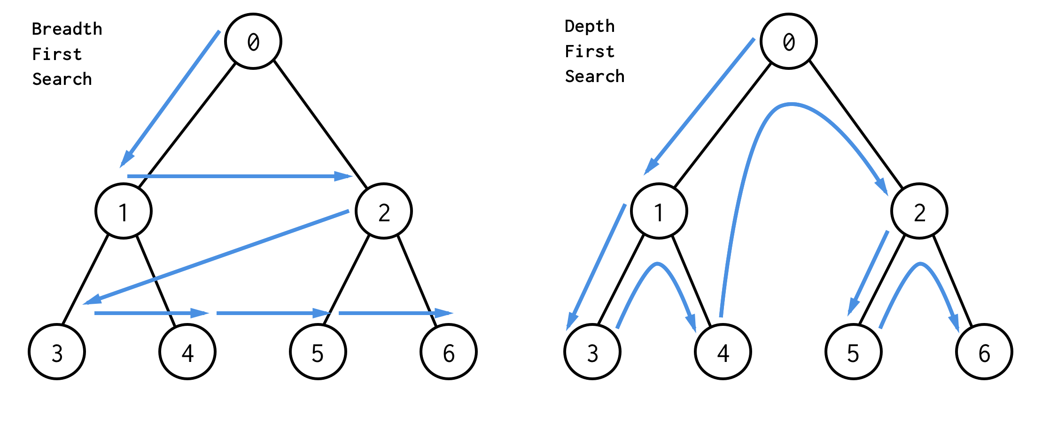
Depth-First Strategy versus Breadth-First Strategy
In Depth-First Search, the FRINGE (frontier) is implemented
using a (data-structure) ?
While in Breadth-First Search, the FRINGE (frontier) is
implemented using a (data-structure) ?

Slide 48
Depth-Limited Strategy
Depth-first with depth cutoff k (maximal depth below which nodes are not expanded)
Three possible outcomes:
Solution.
Failure (no solution).
Cutoff (no solution within cutoff).
Iterative-Deepening Strategy
Repeat for k = 0, 1, 2, .. :
- Perform depth-first with depth cutoff k

Slide 49
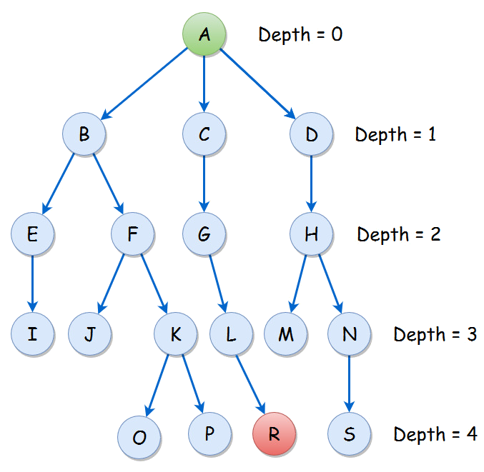
Depth-Limited Strategy
E.g., depth cutoff k = 1
Iterative-Deepening Strategy
E.g., Repeat for k = 0 to 4
- Perform depth-first with depth cutoff k

Slide 50
Comparing Depth, Breadth, & Iterative Deepening Search Algorithms
Breadth-first and iterative deepening guarantee shortest
solution.
Breadth-first: high space complexity.
Depth-first: low space complexity, but may search well below solution depth.
Iterative deepening: best performance in terms of orders
of complexity.

Slide 51
Exercise

Slide 52
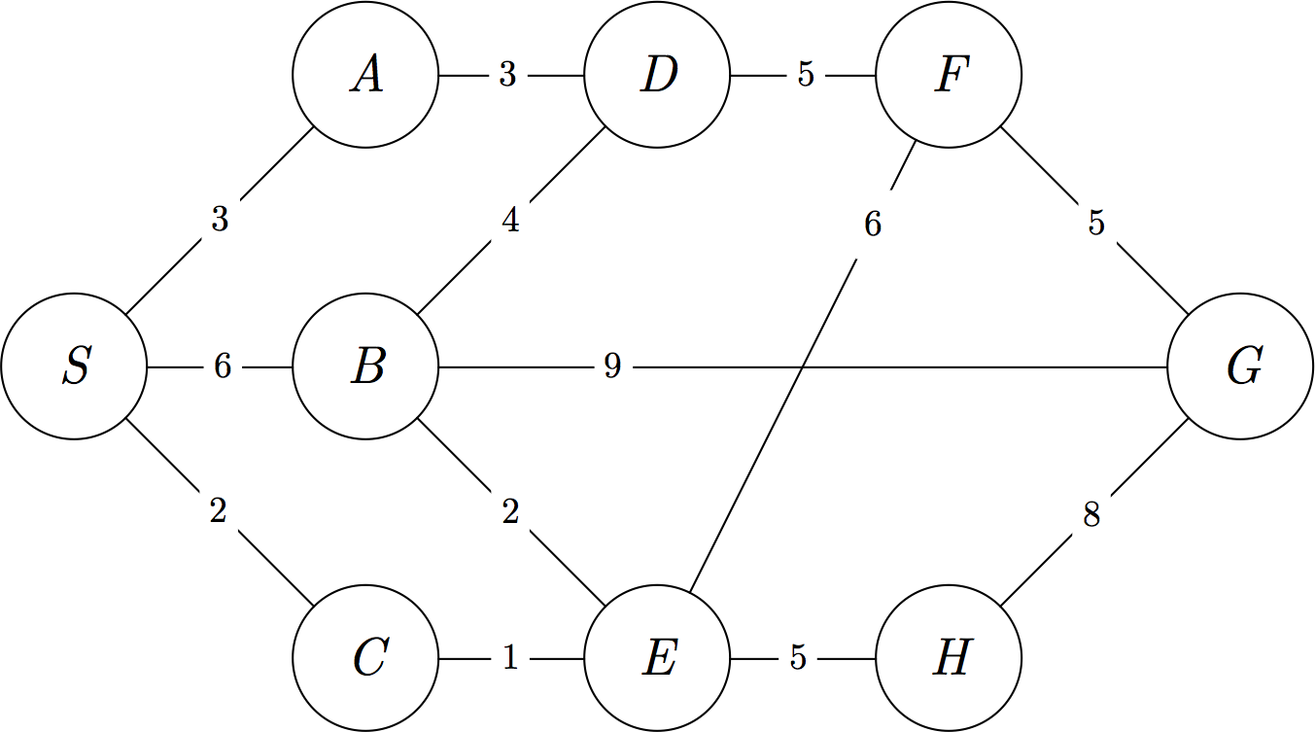
Exercise
Question: What is the order of visits of the nodes and the
path returned by BFS, DFS and UCS?

Slide 53
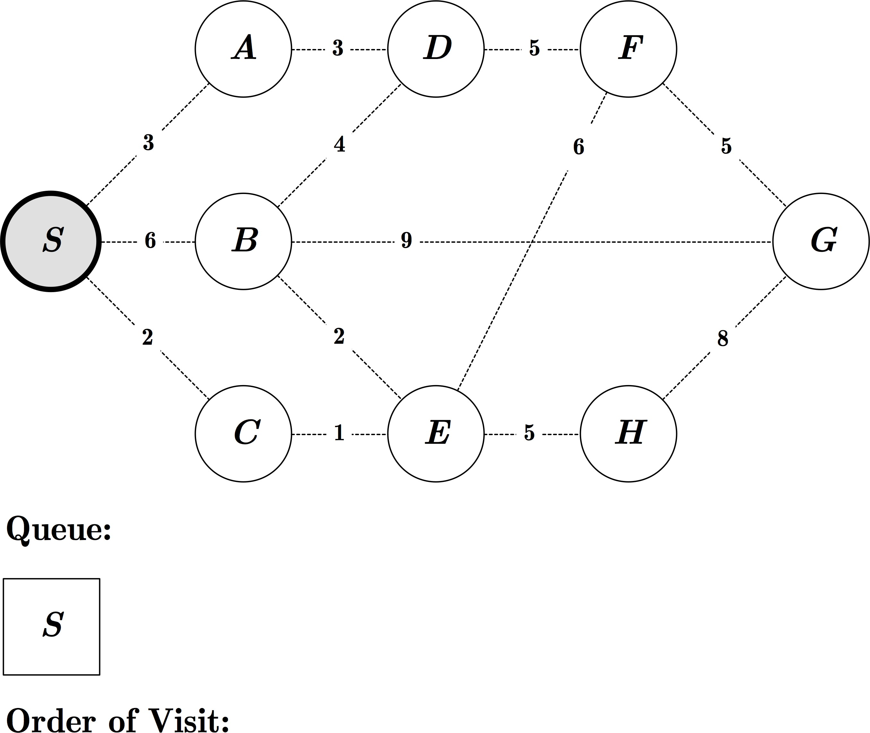
Exercise: BFS

Slide 54
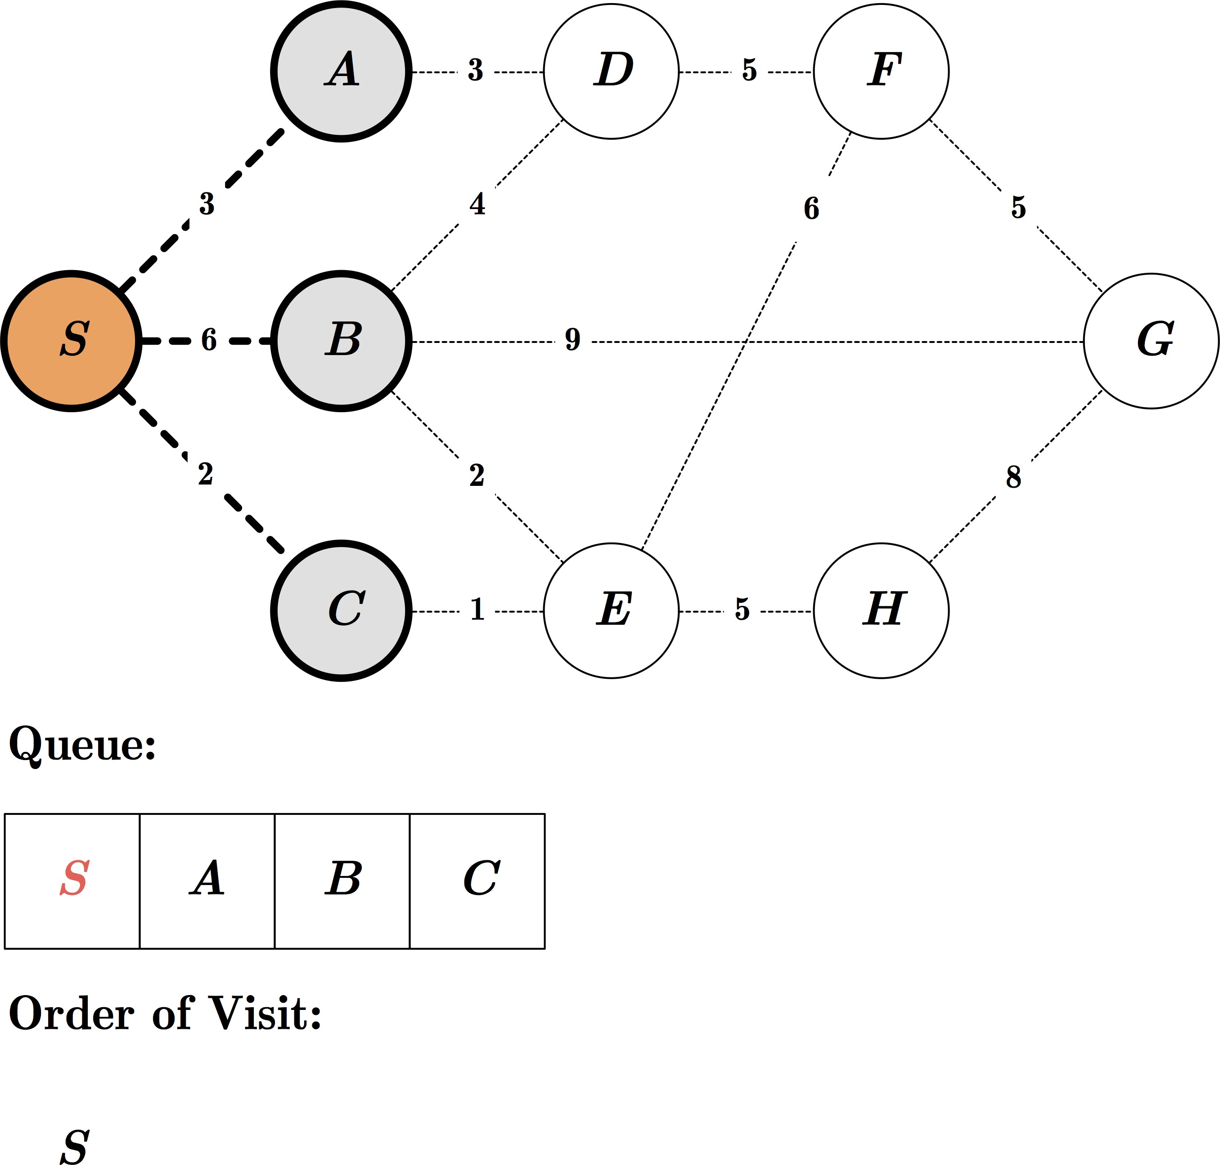
Exercise: BFS

Slide 55
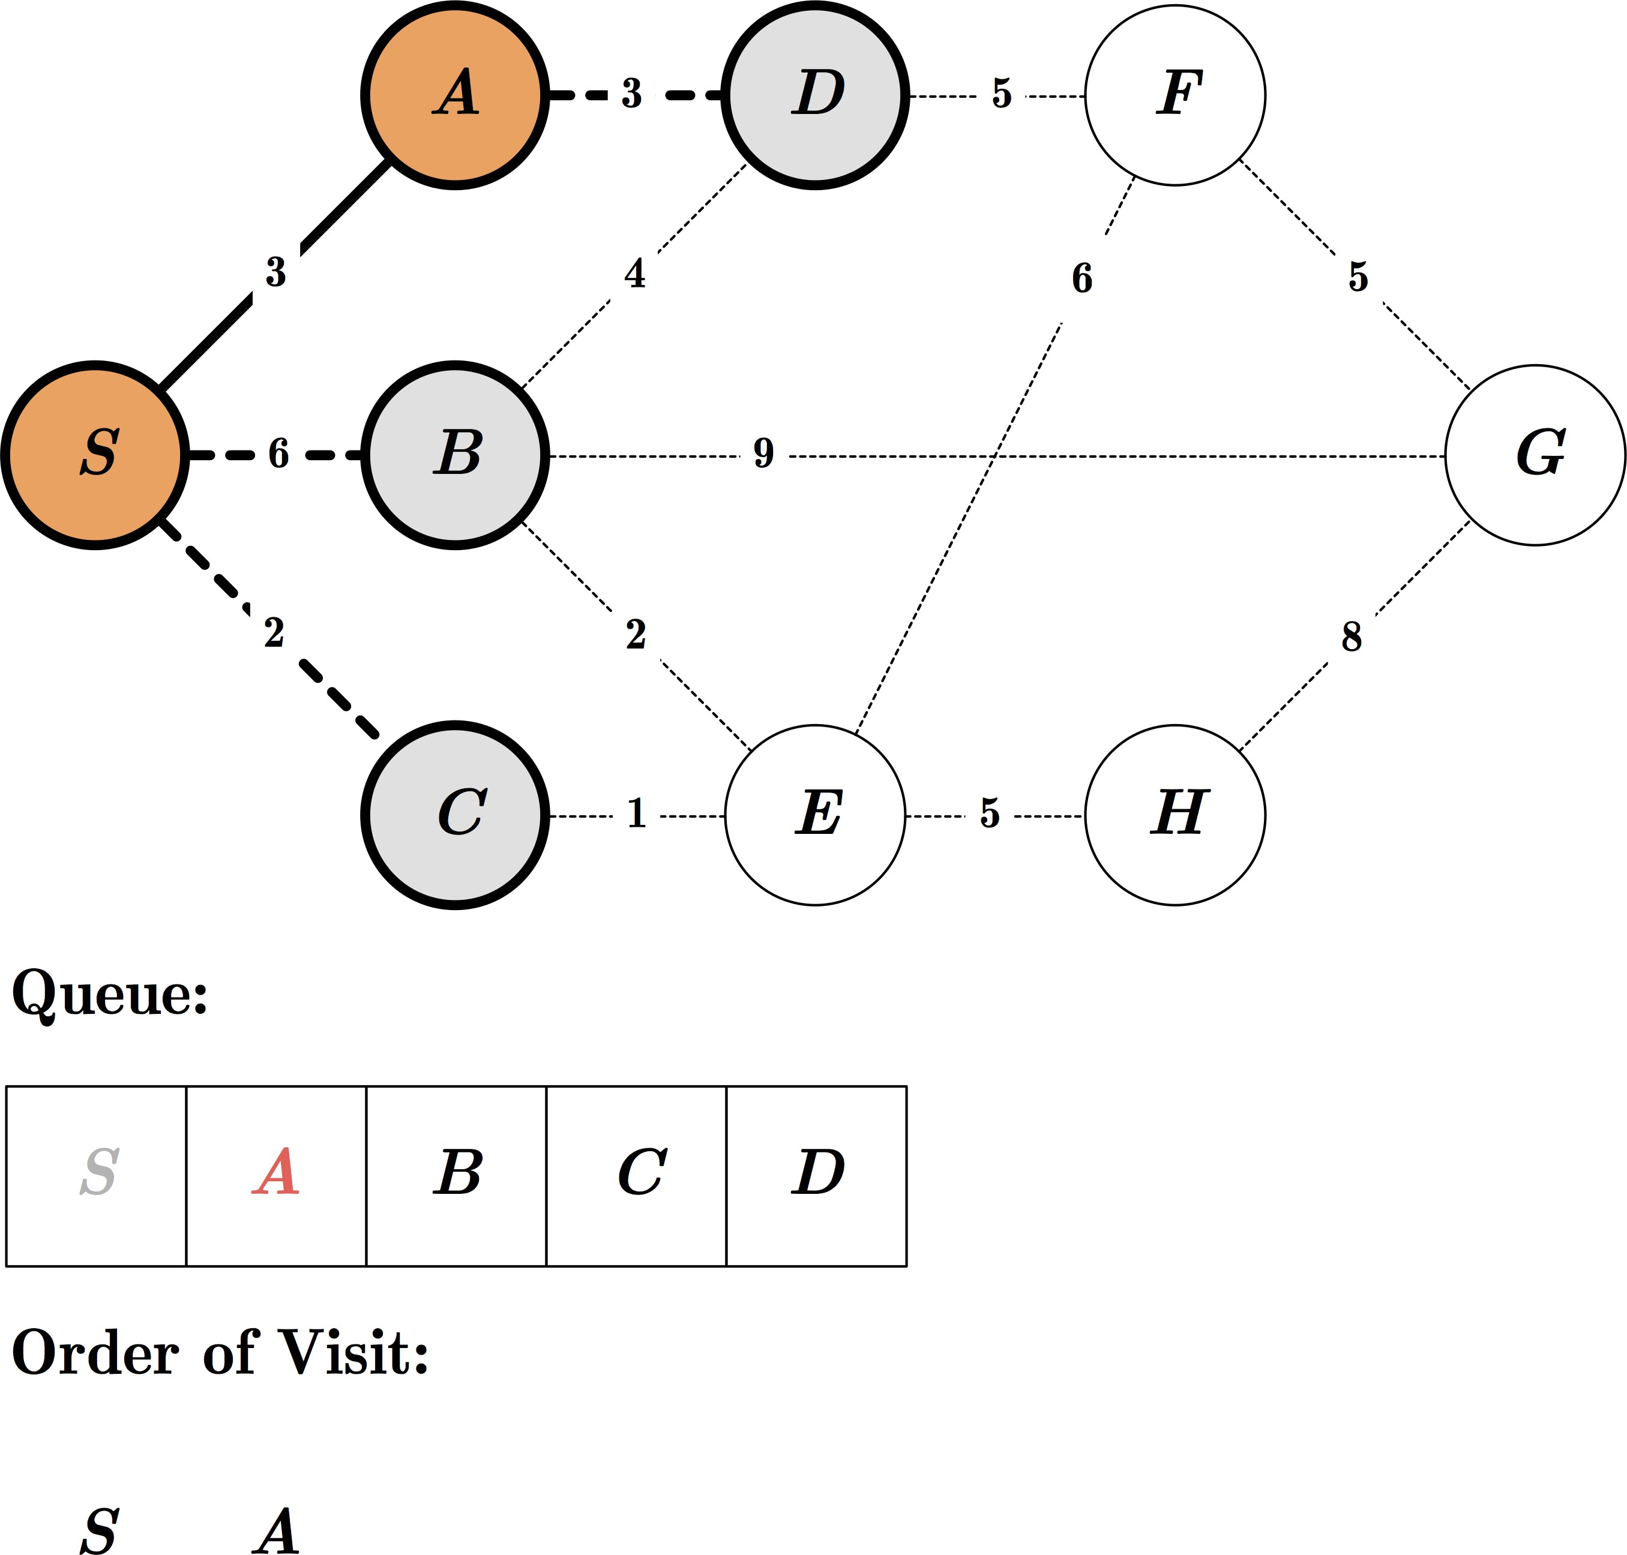
Exercise: BFS

Slide 56
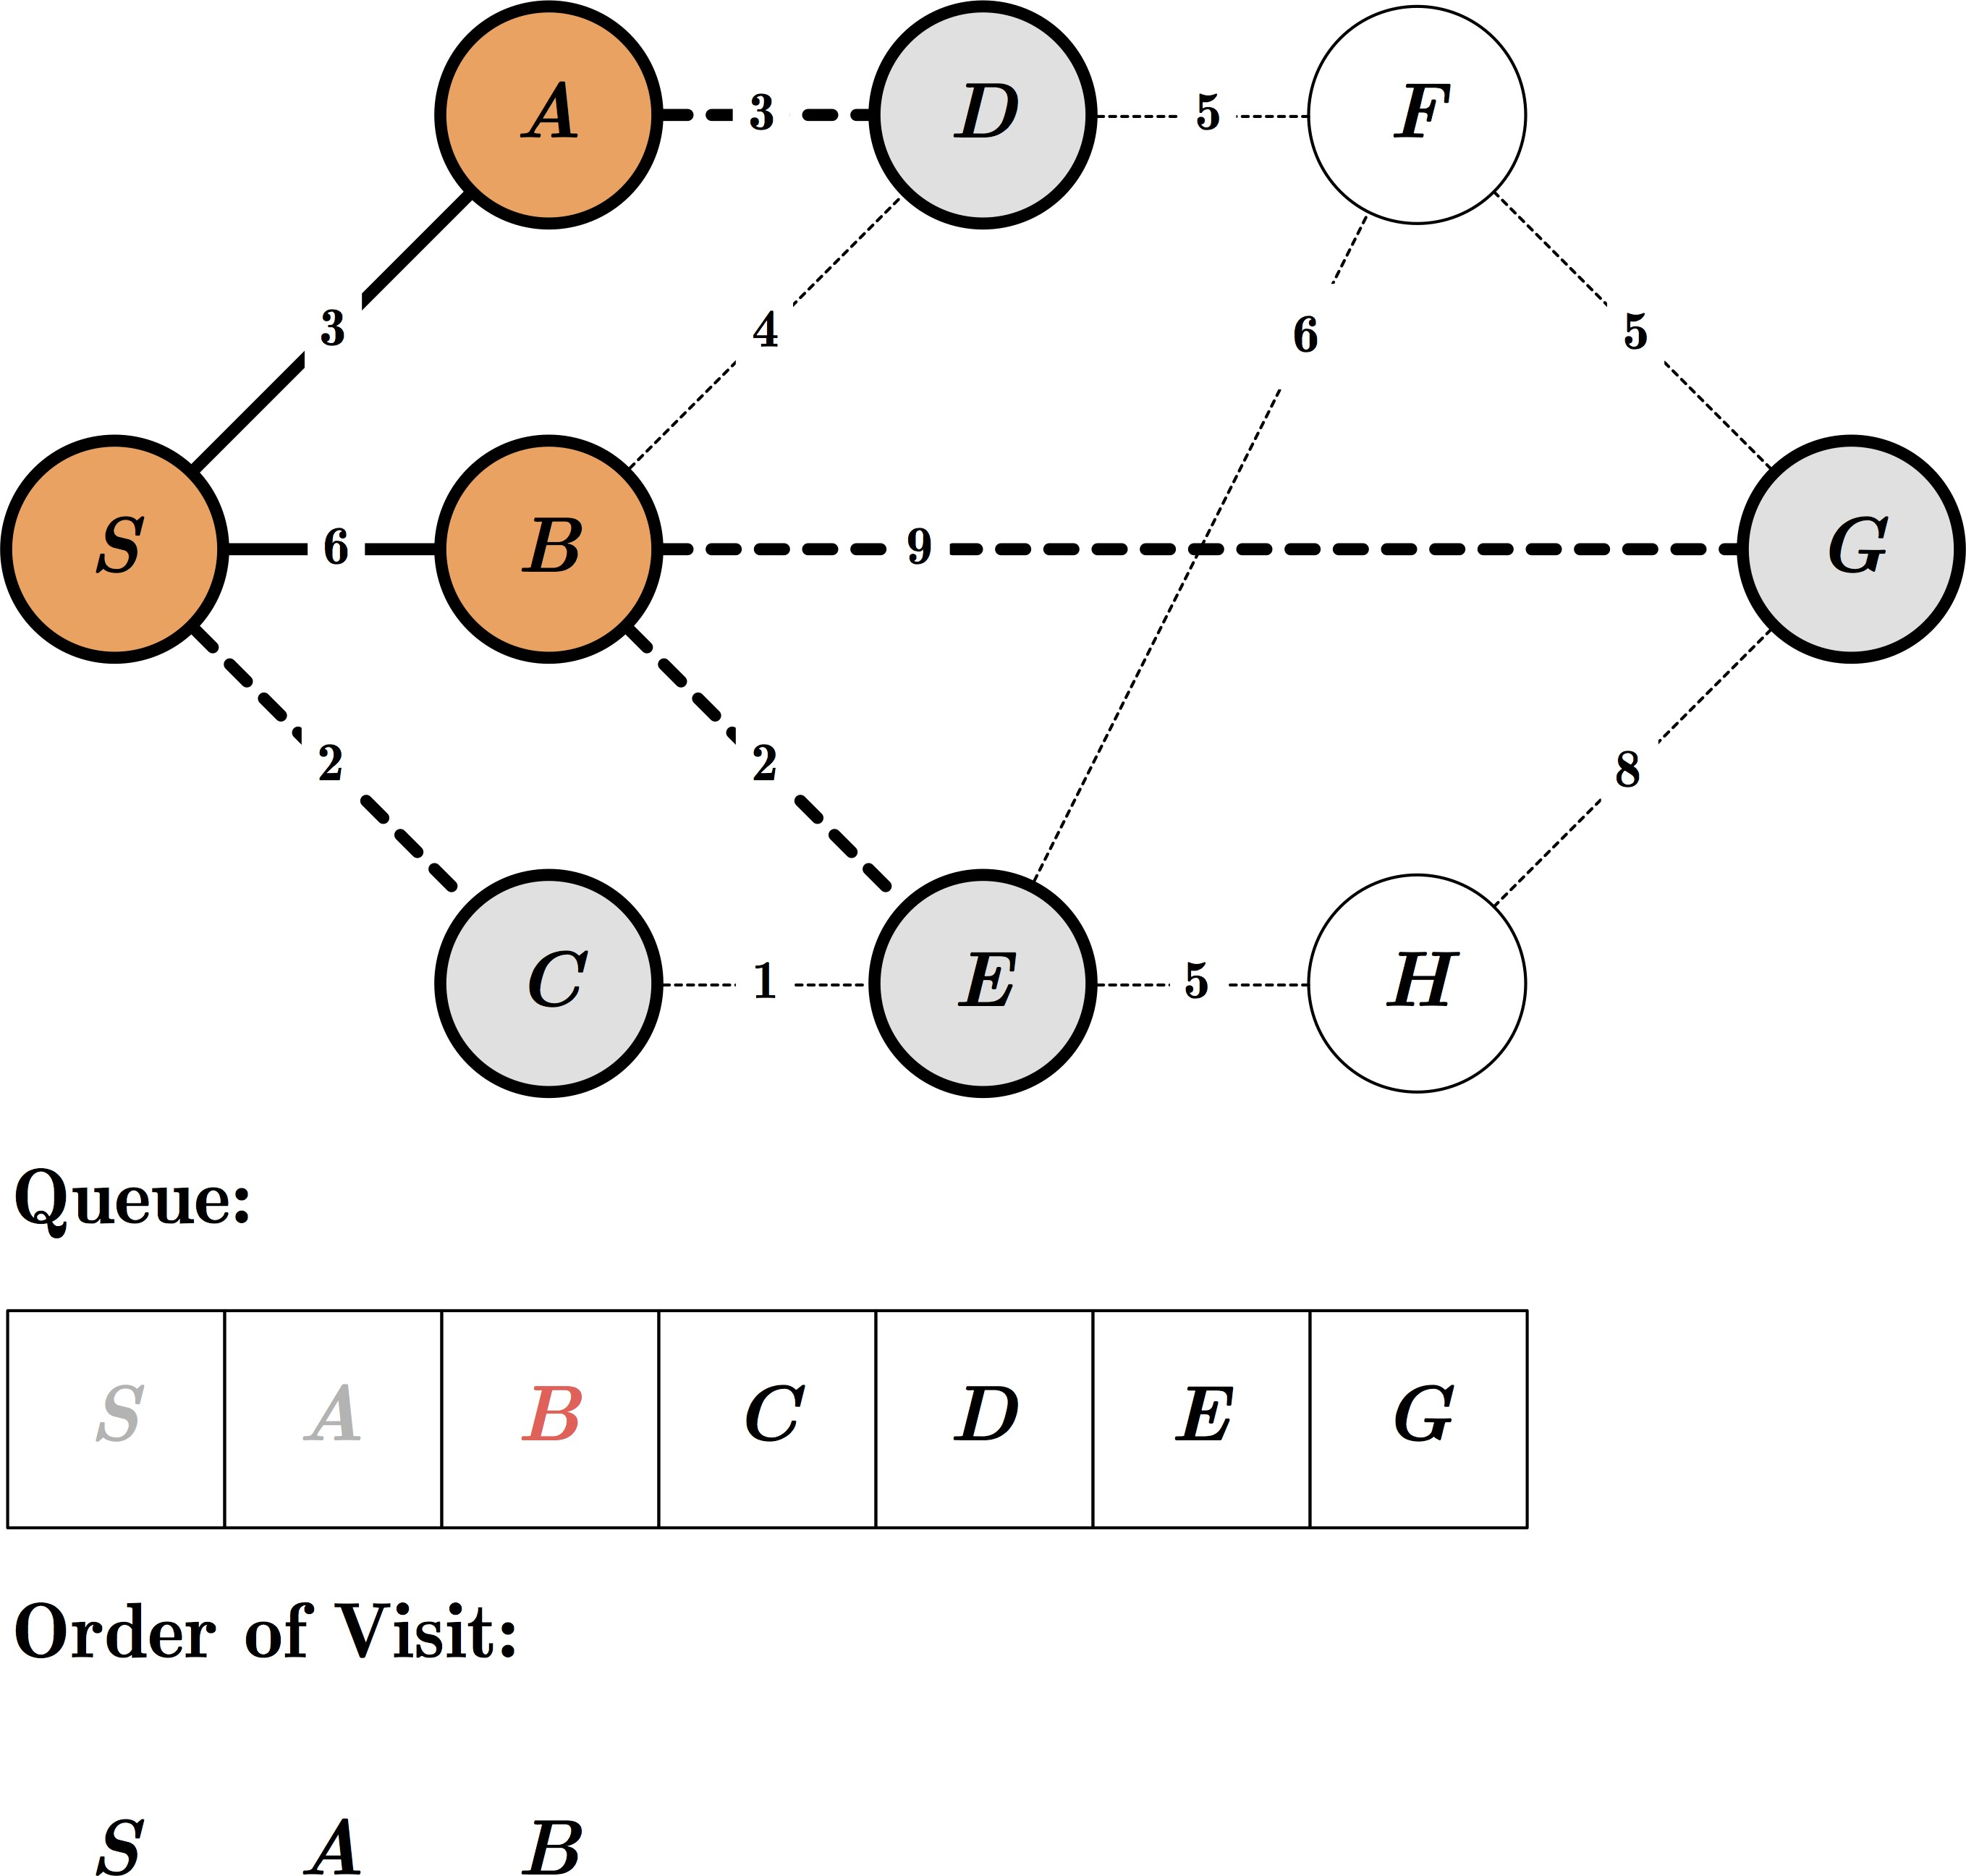
Exercise: BFS

Slide 57
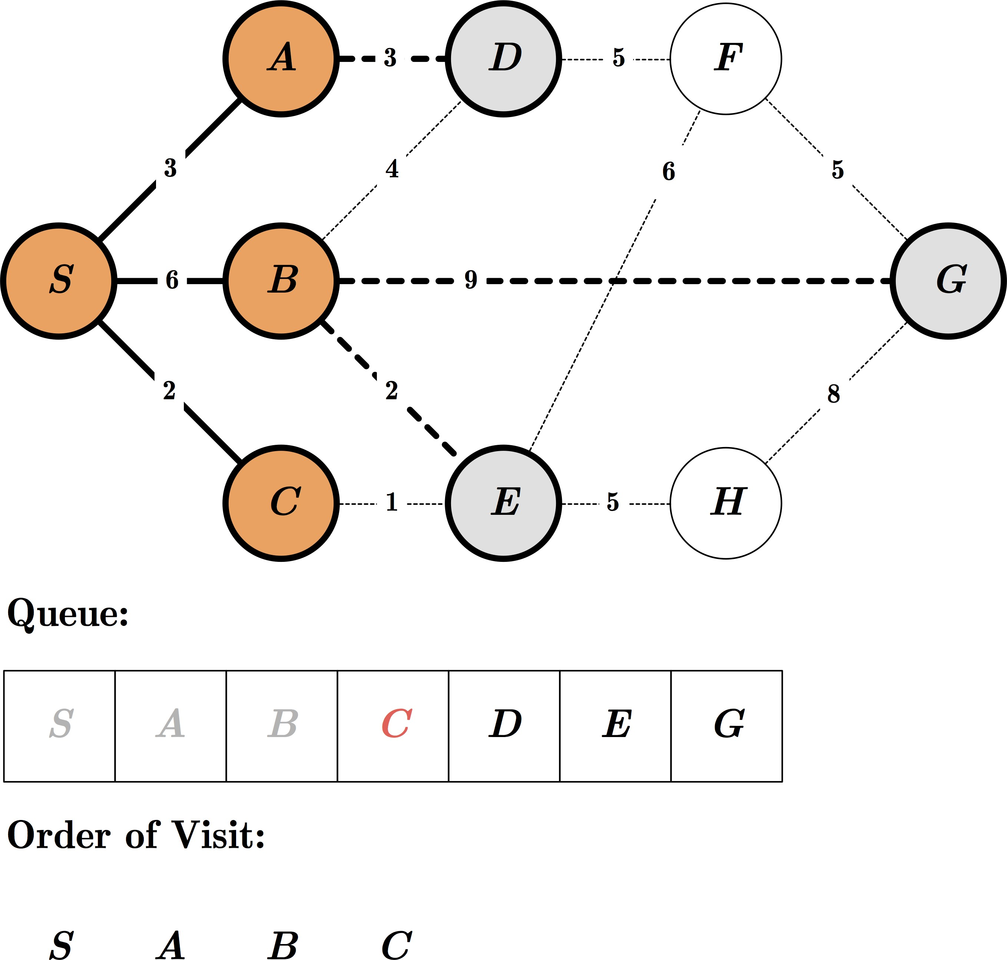
Exercise: BFS

Slide 58
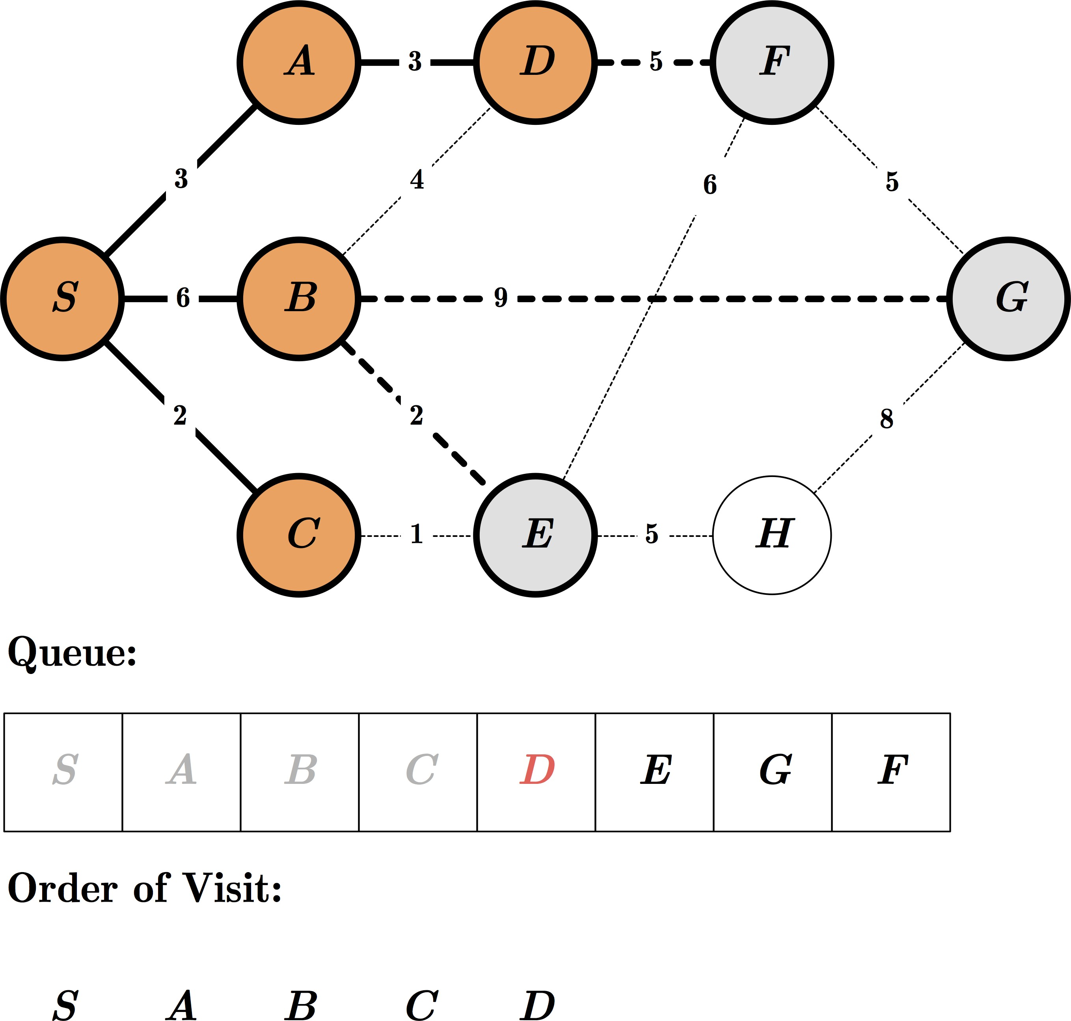
Exercise: BFS

Slide 59
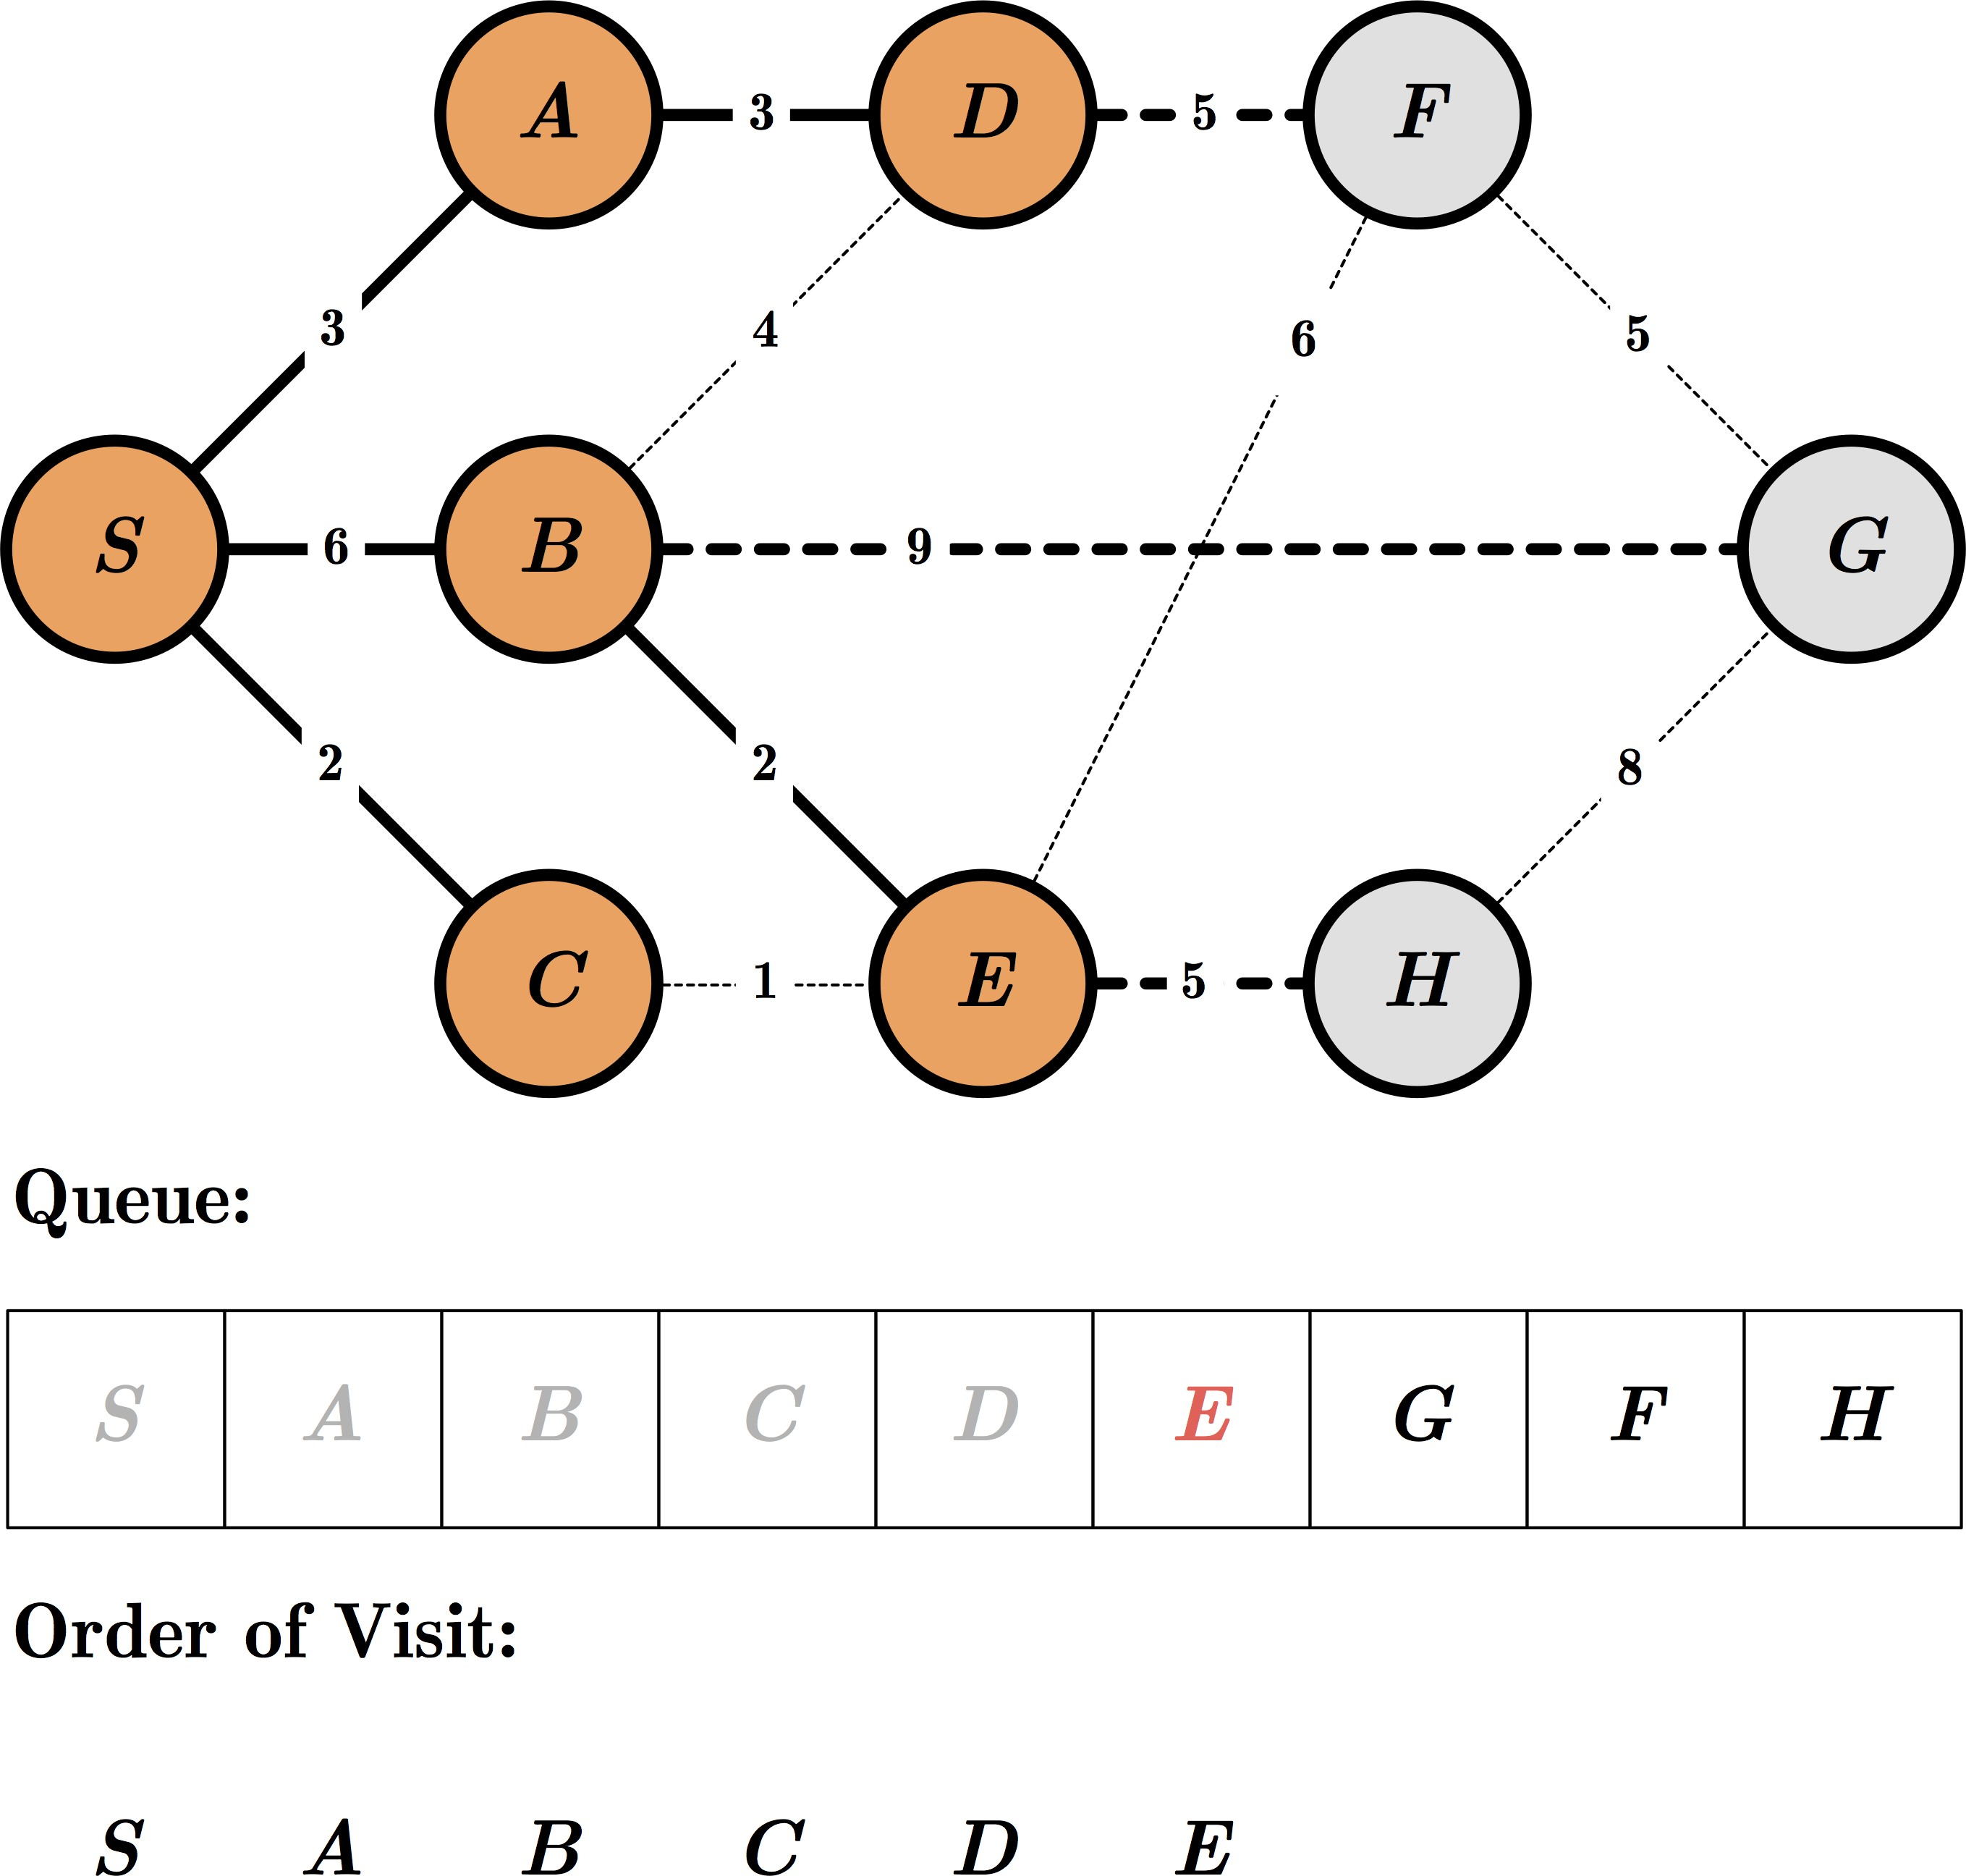
Exercise: BFS

Slide 60
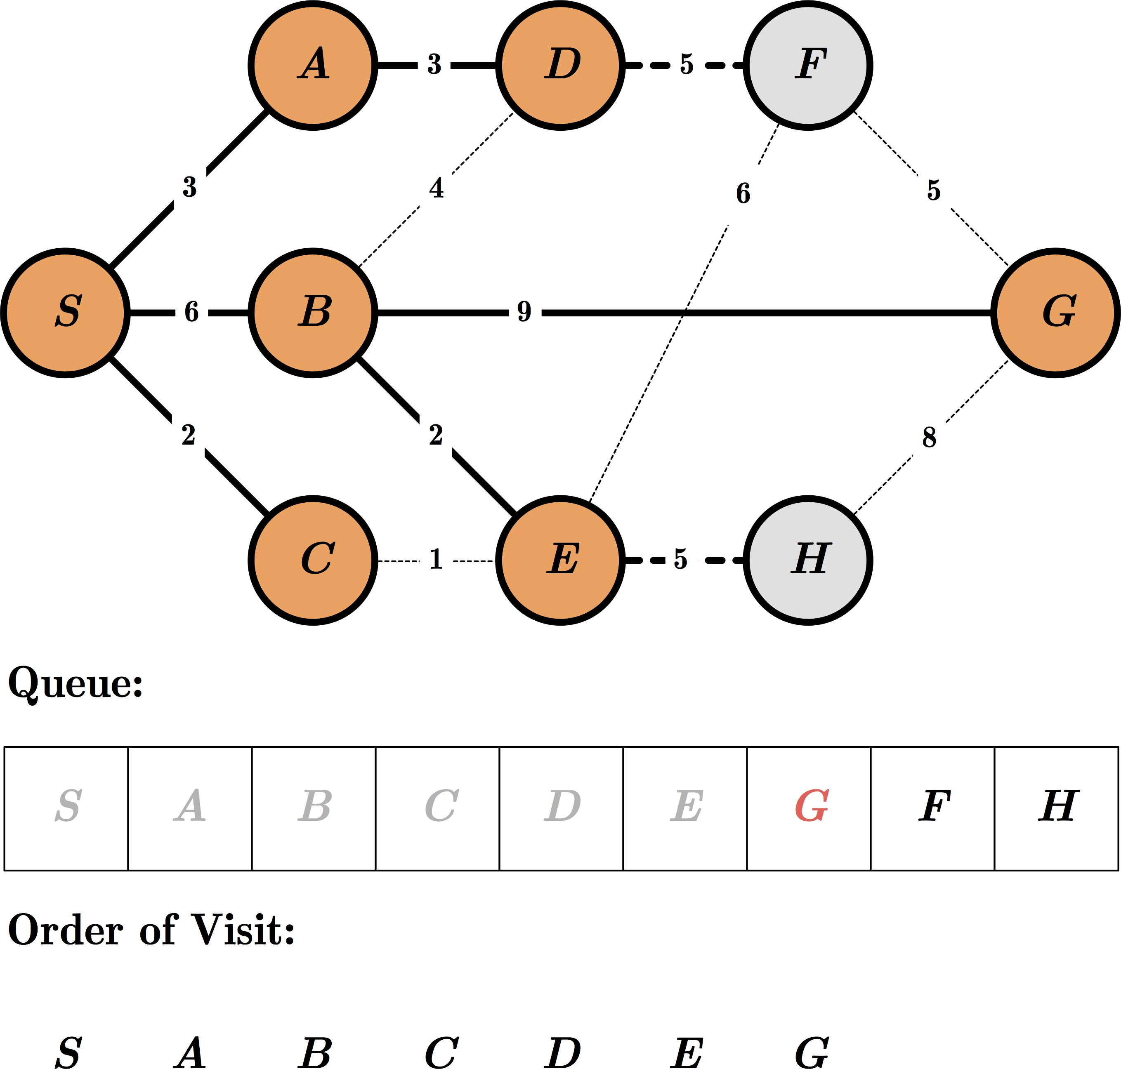
Exercise: BFS

Slide 61
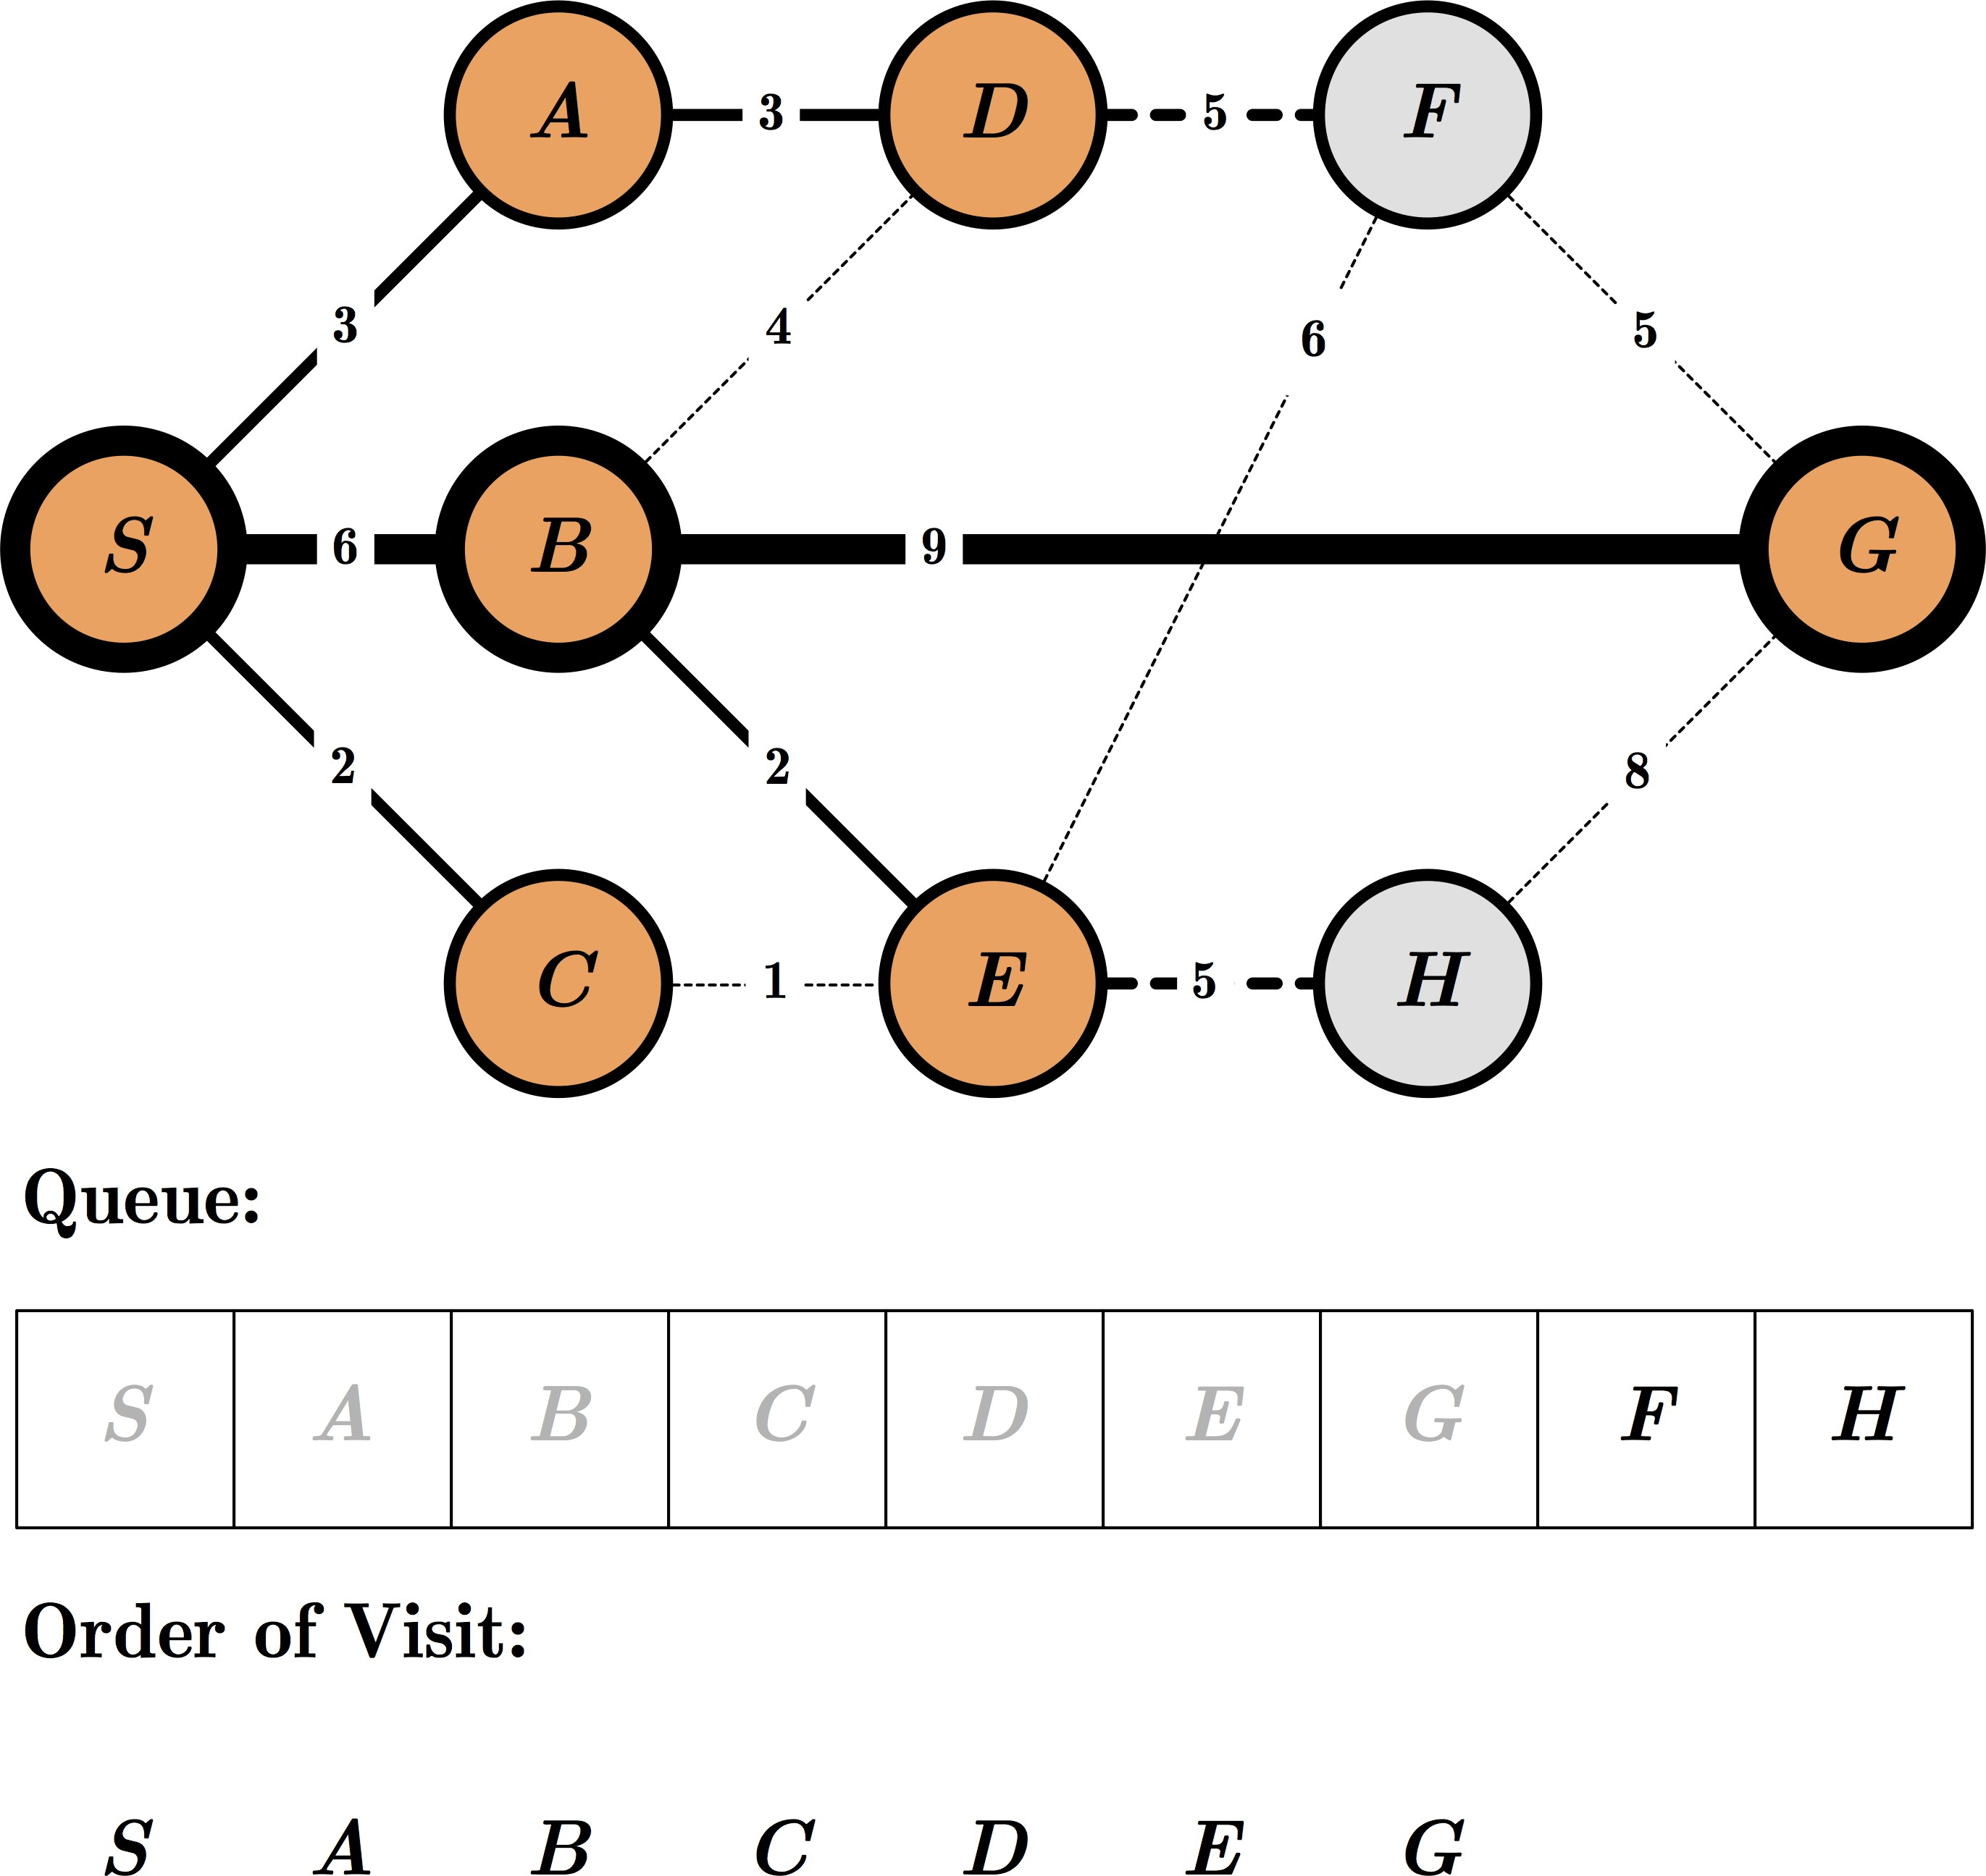
Exercise: BFS

Slide 62
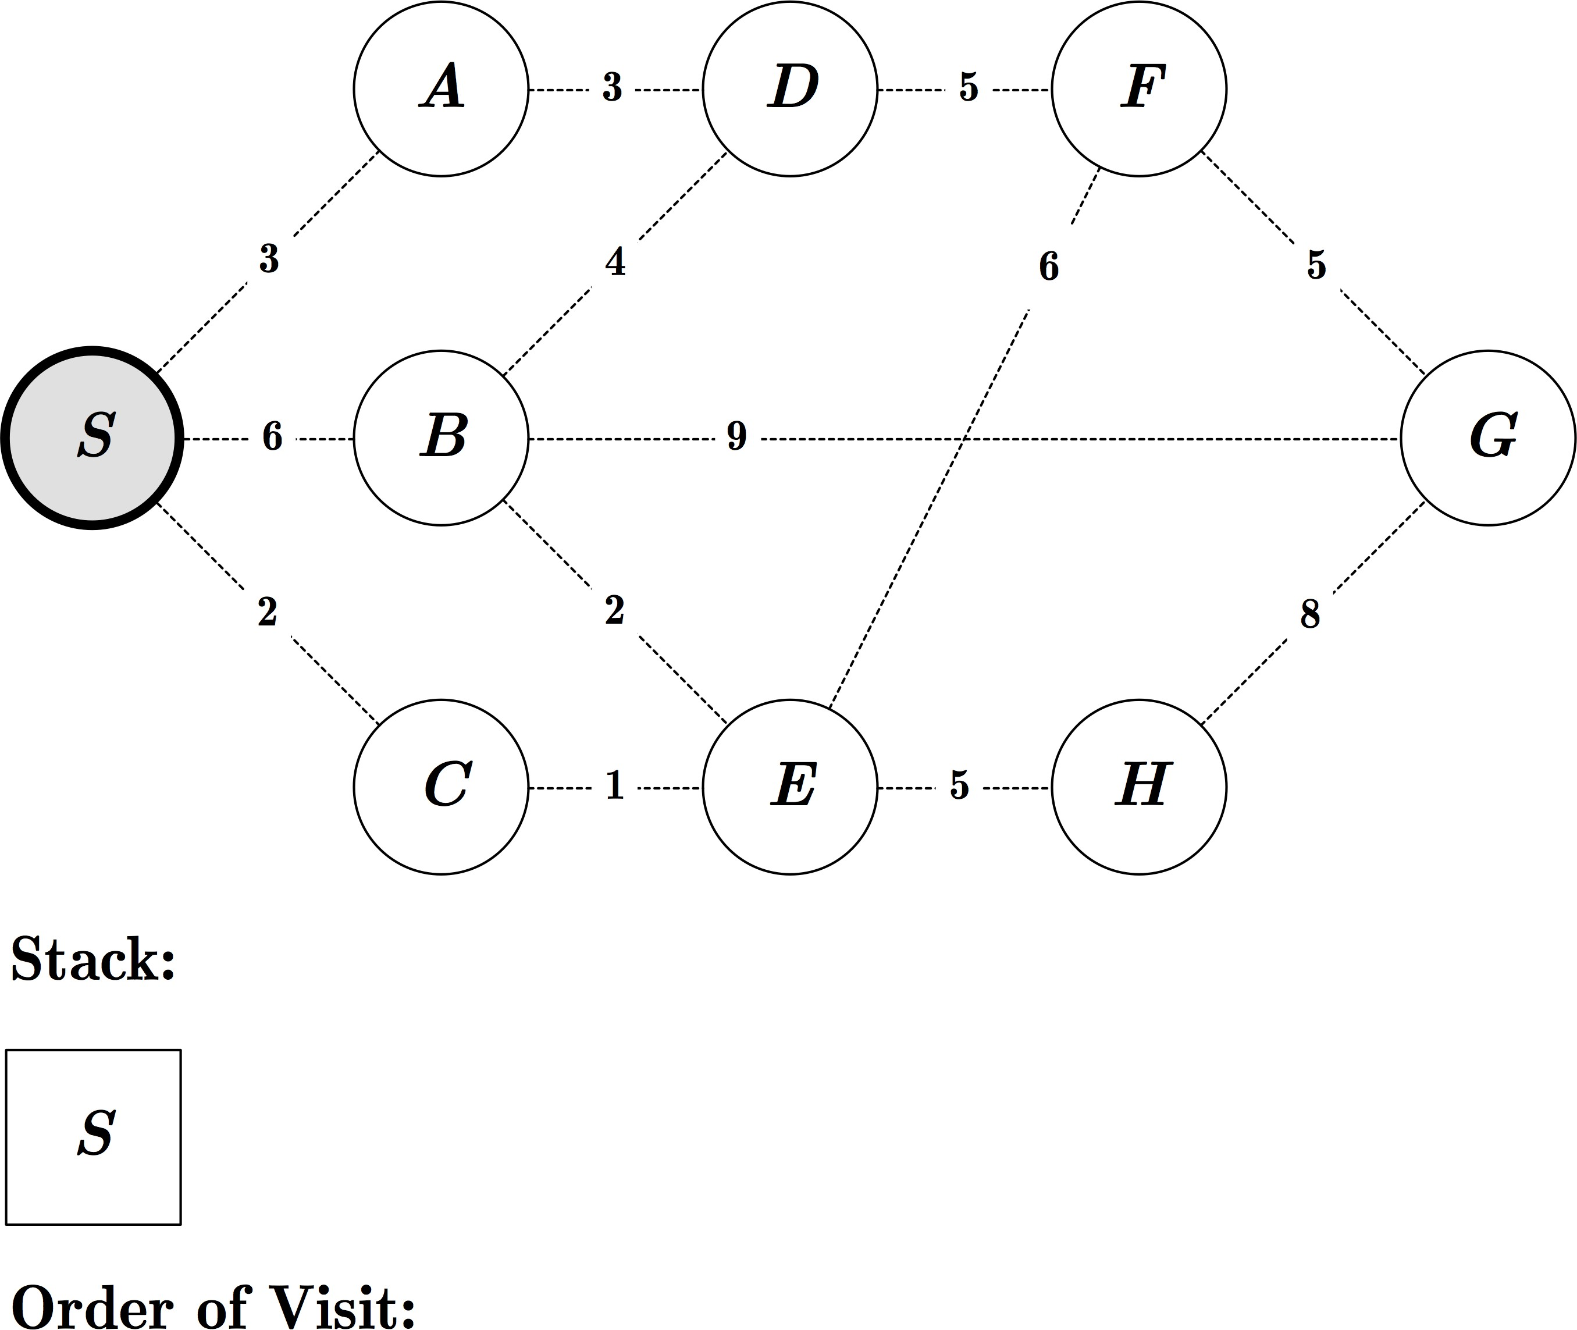
Exercise: DFS

Slide 63

Exercise: DFS

Slide 64
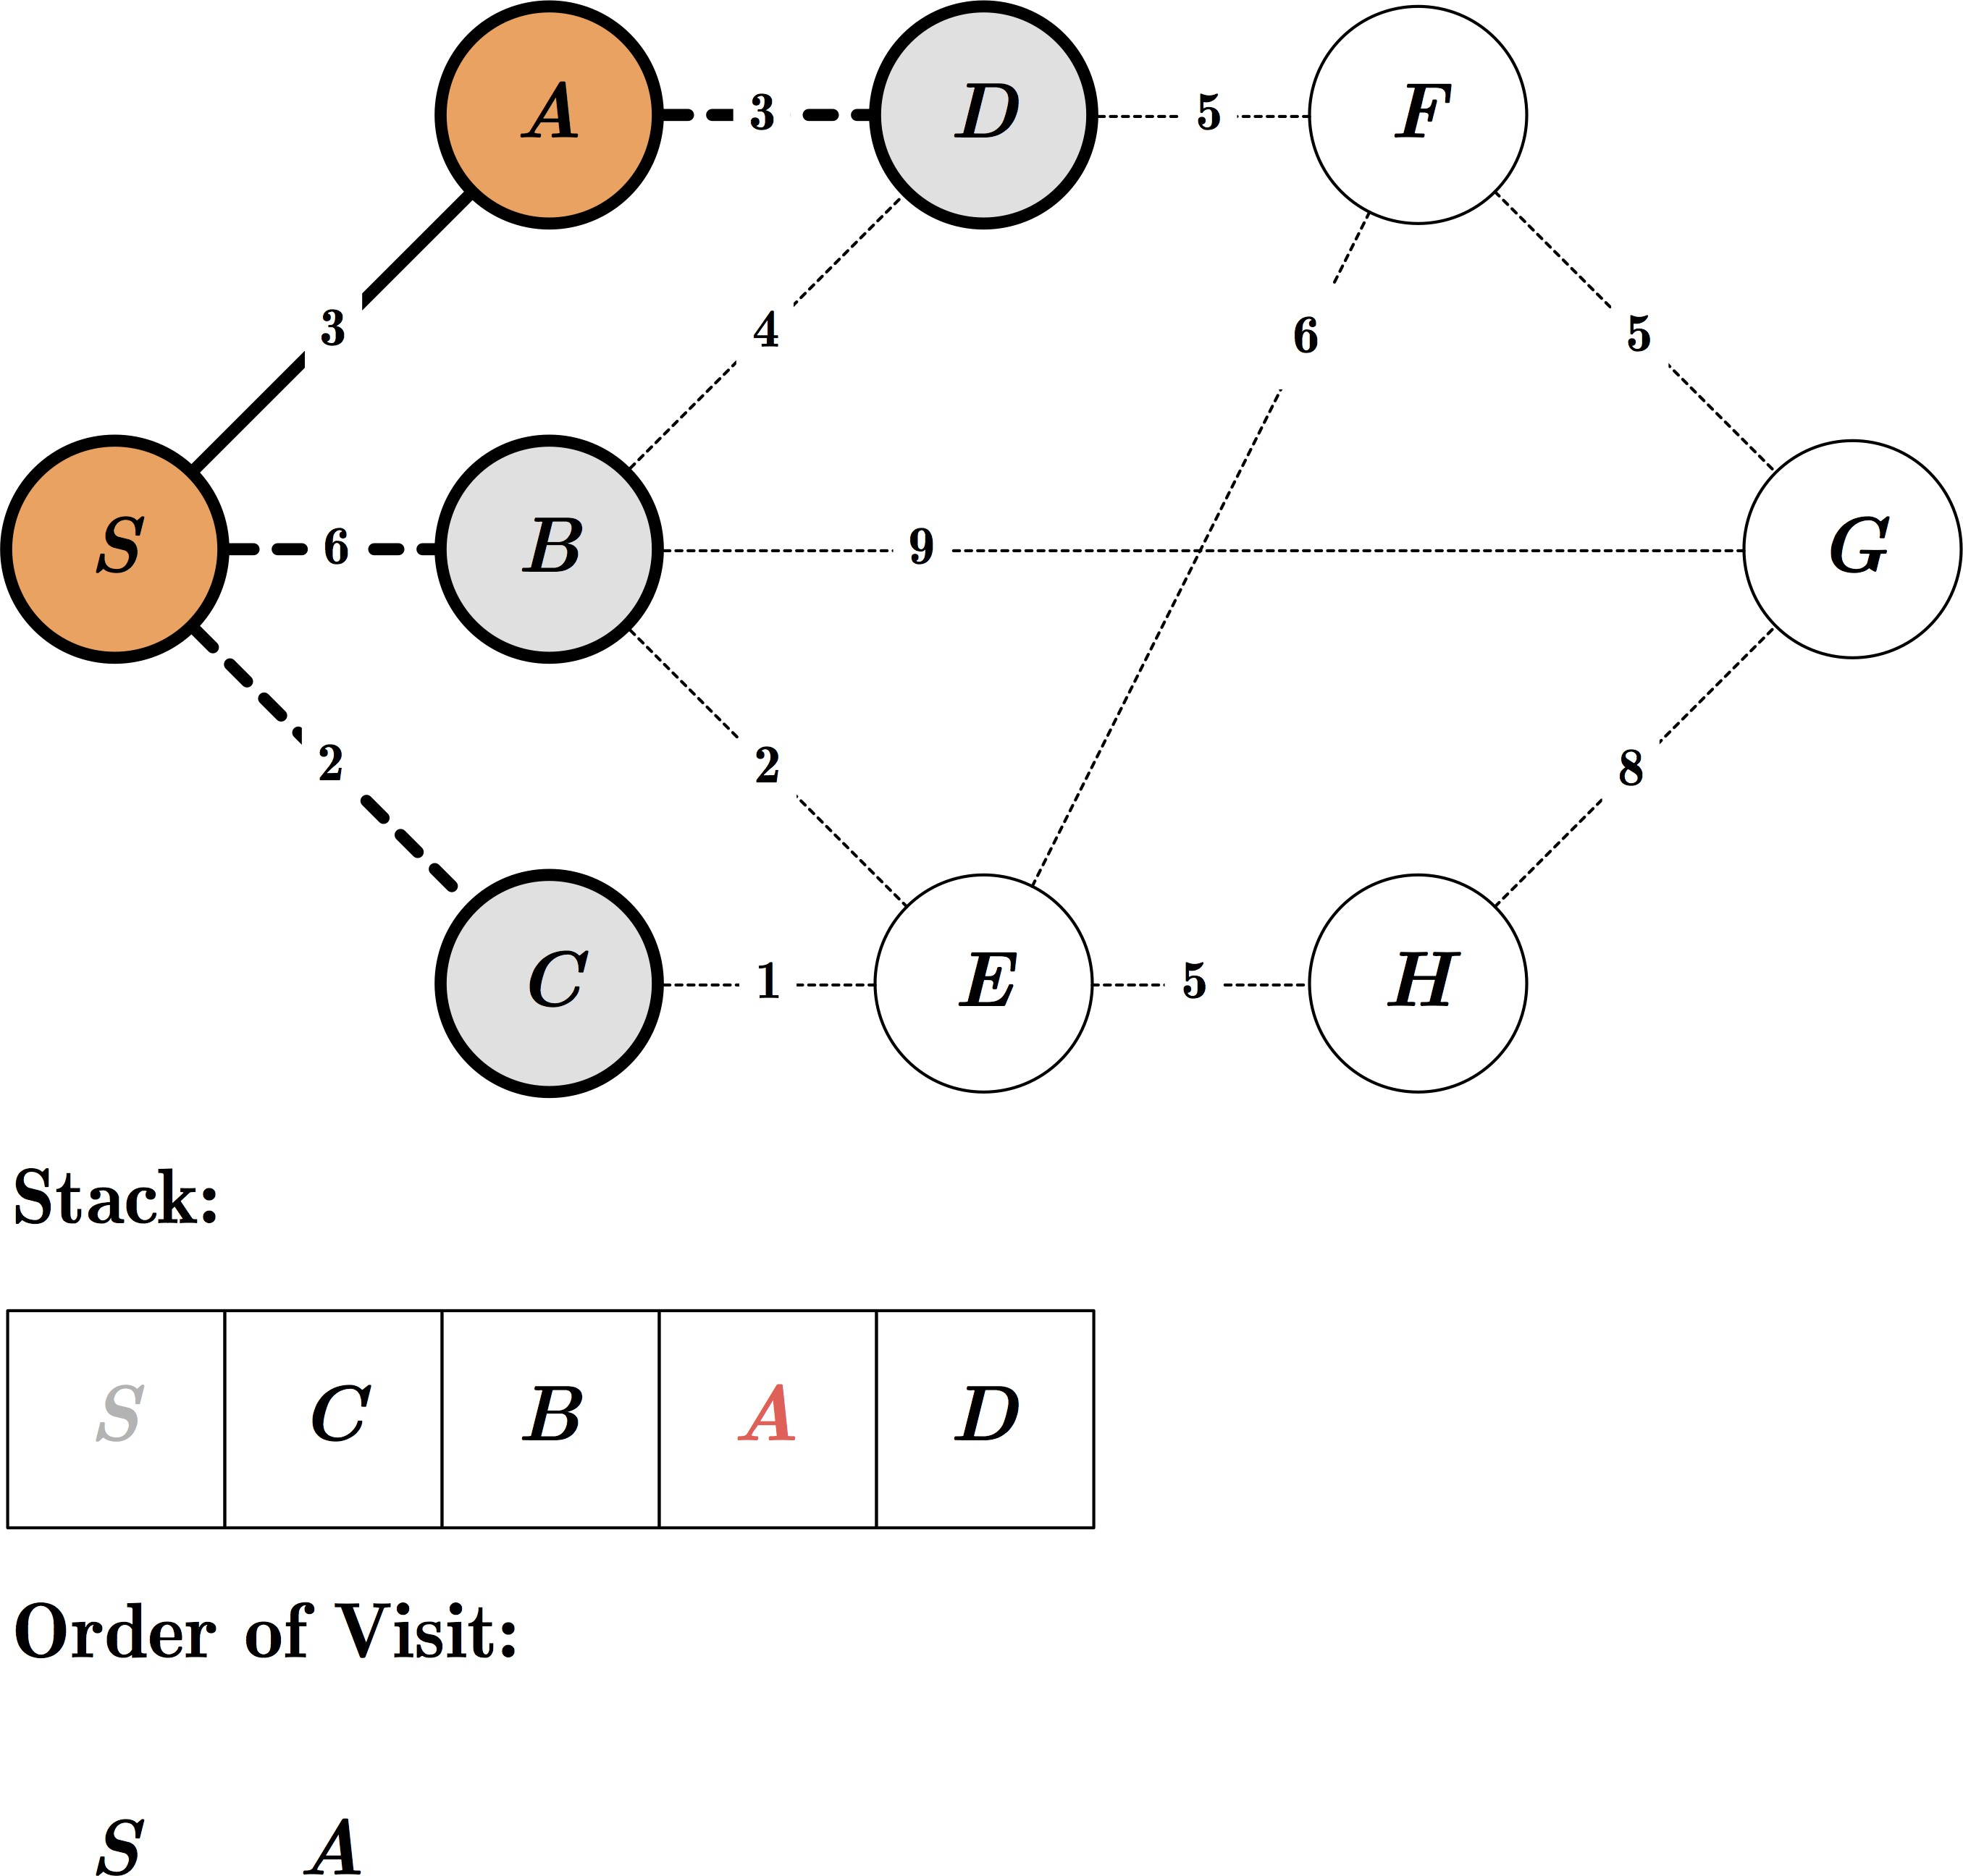
Exercise: DFS

Slide 65
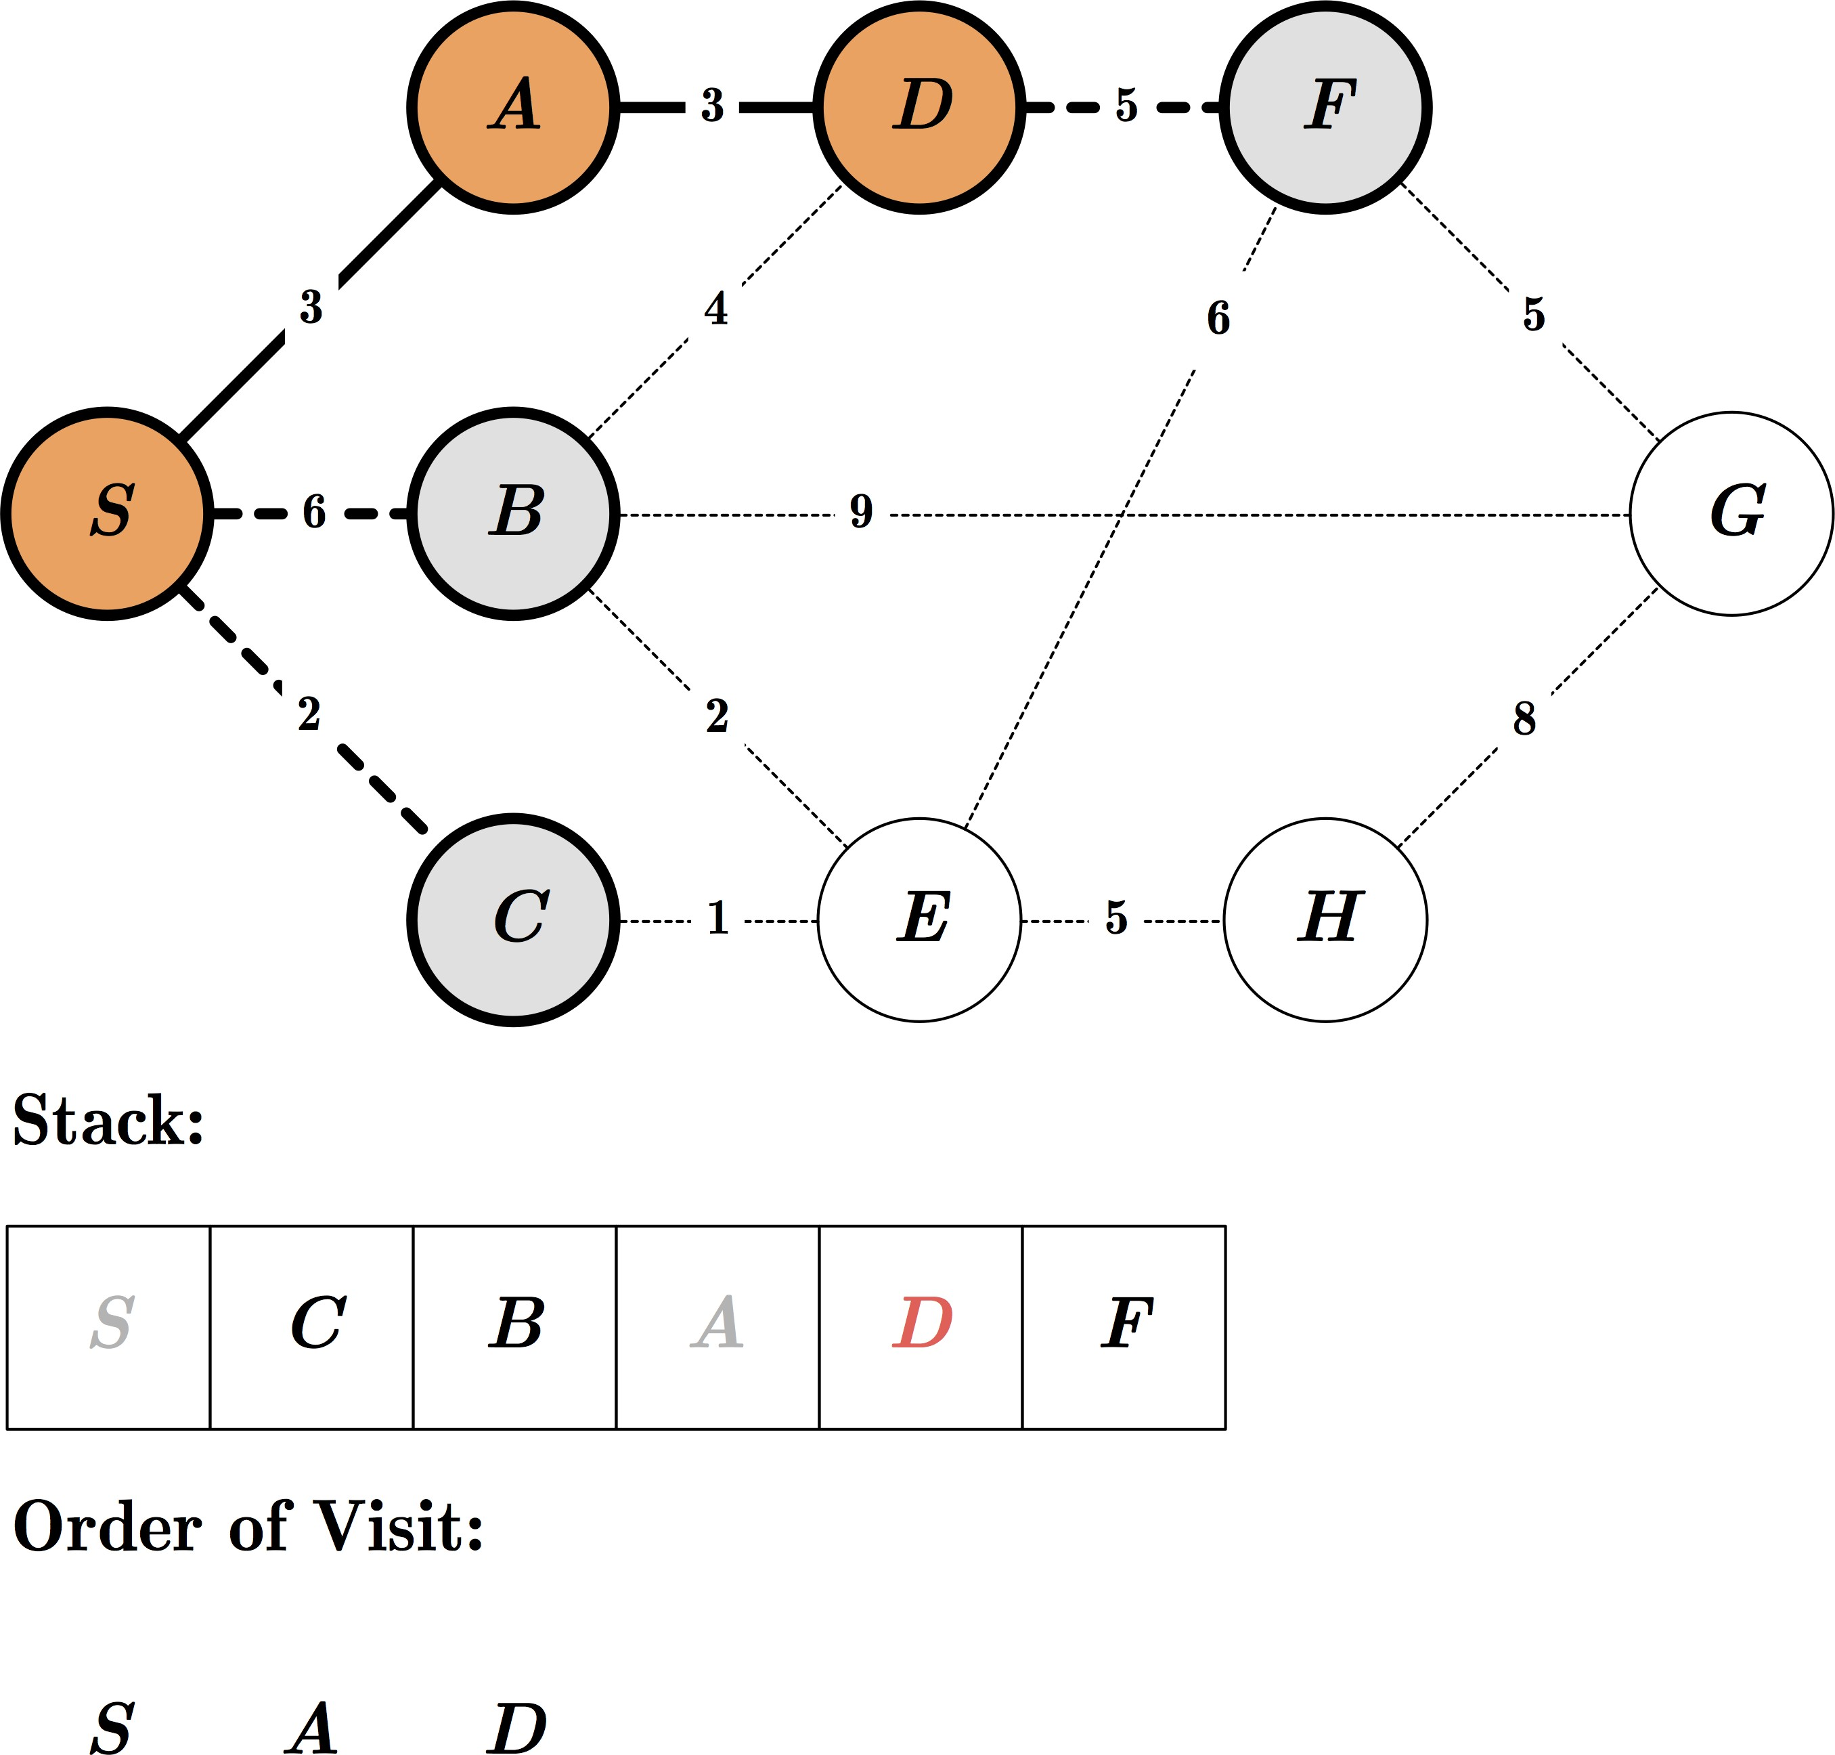
Exercise: DFS

Slide 66
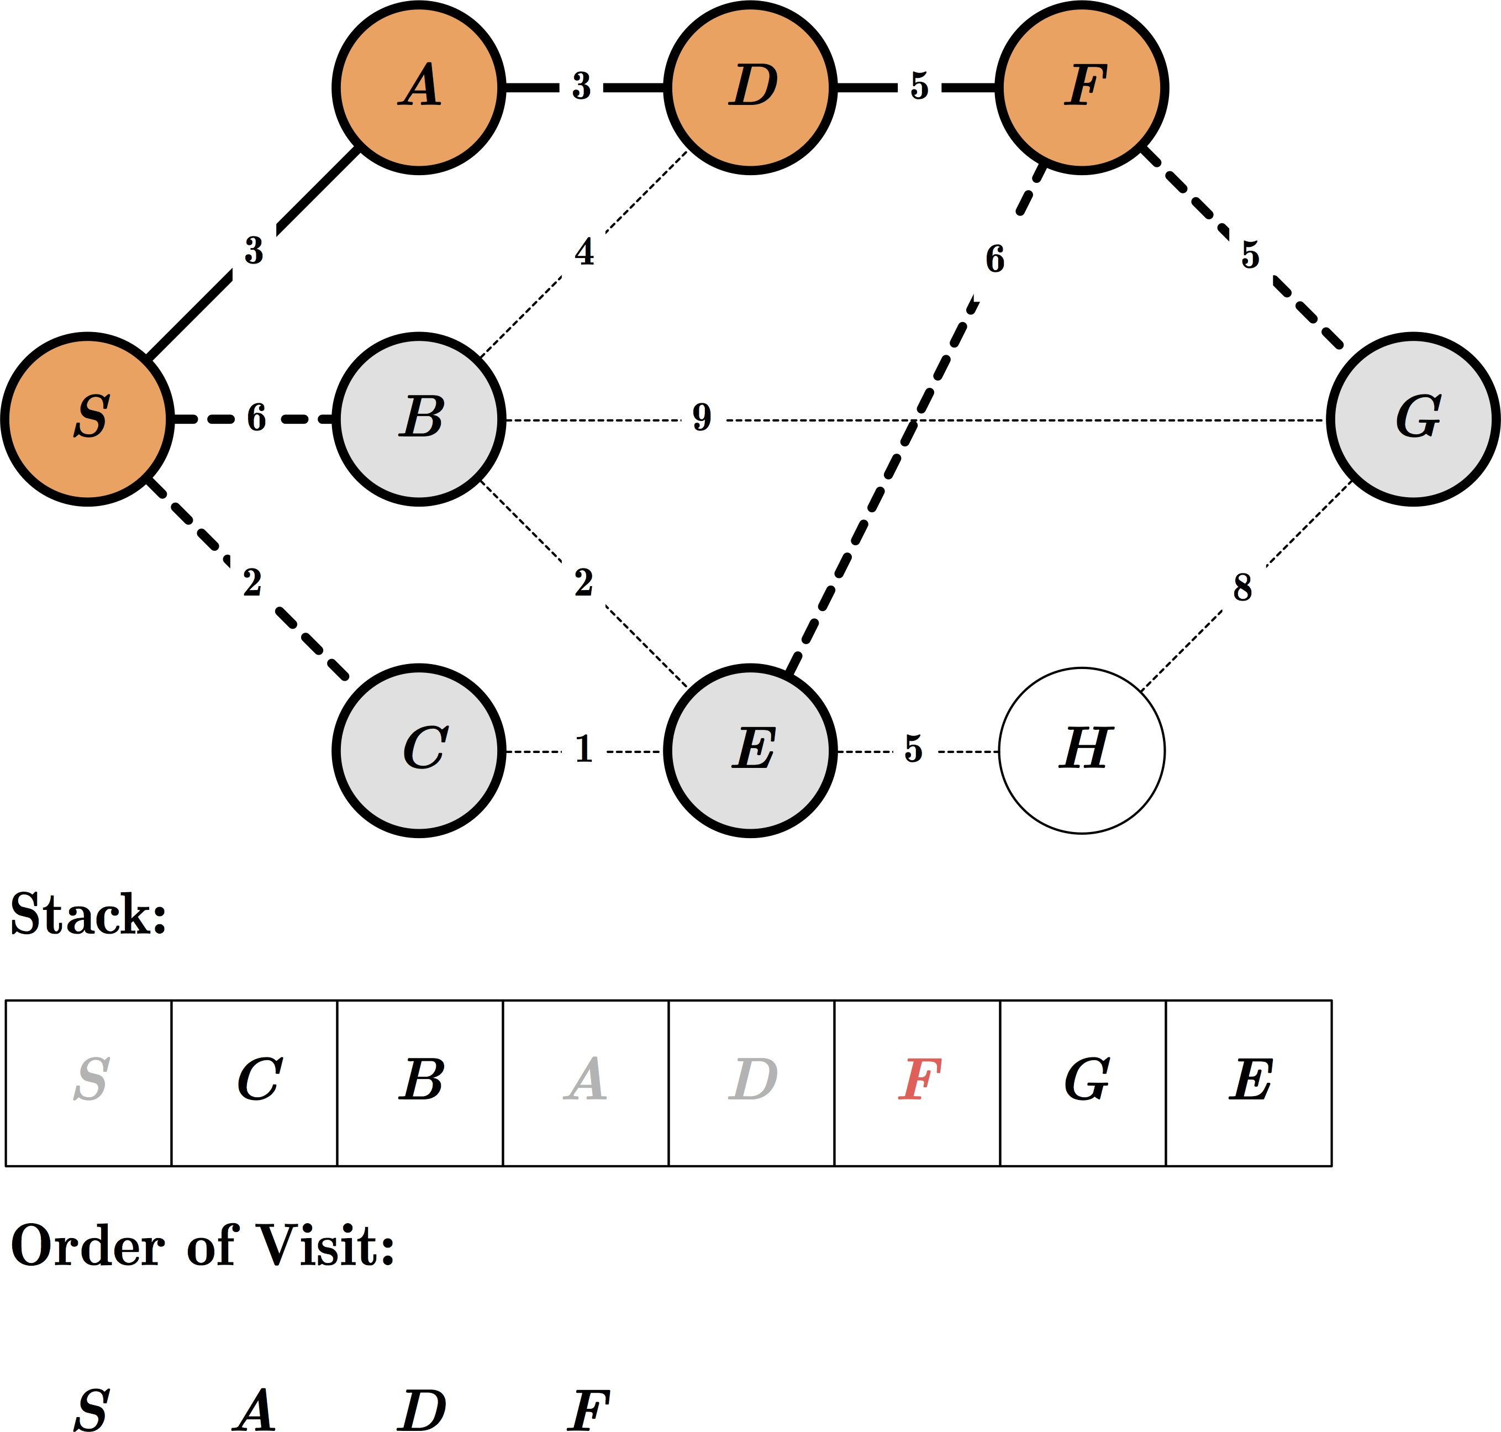
Exercise: DFS

Slide 67
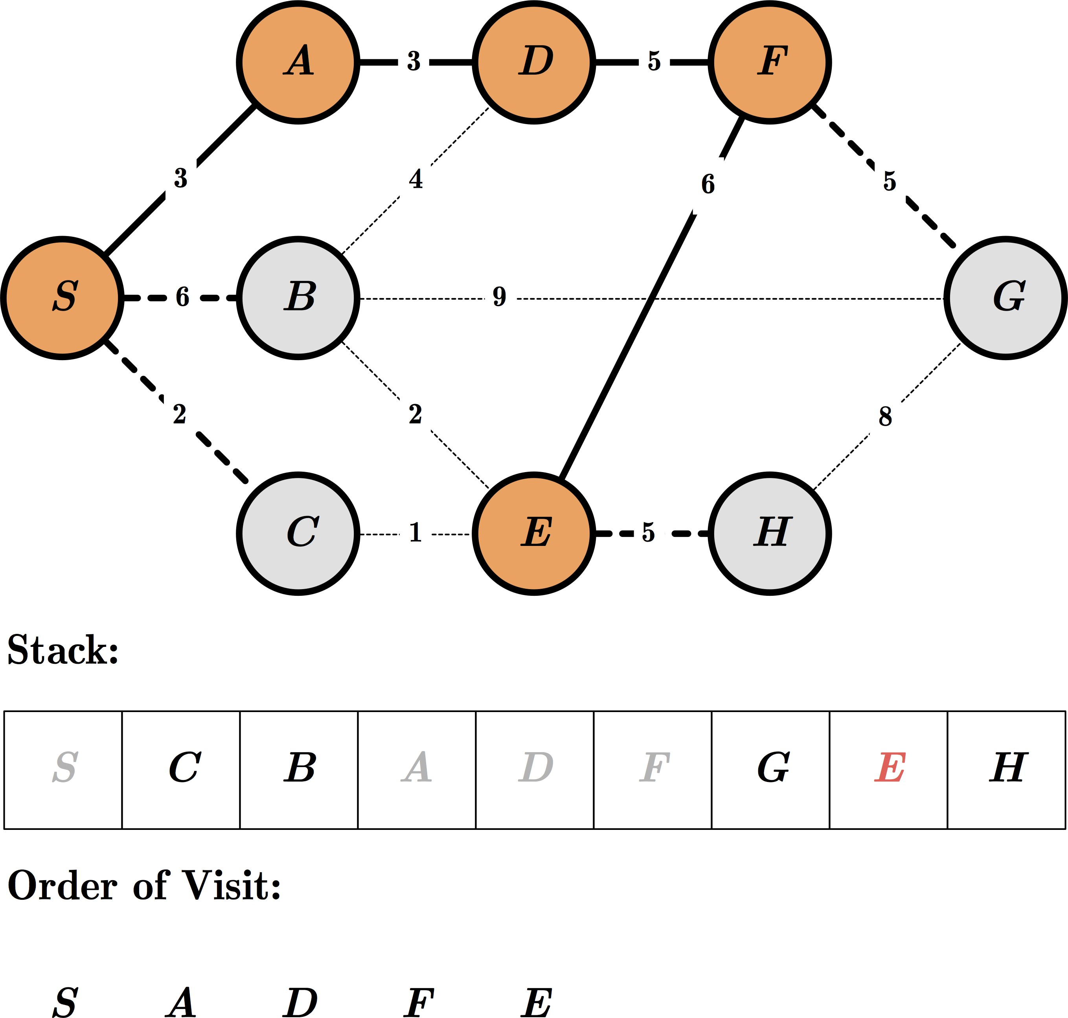
Exercise: DFS

Slide 68
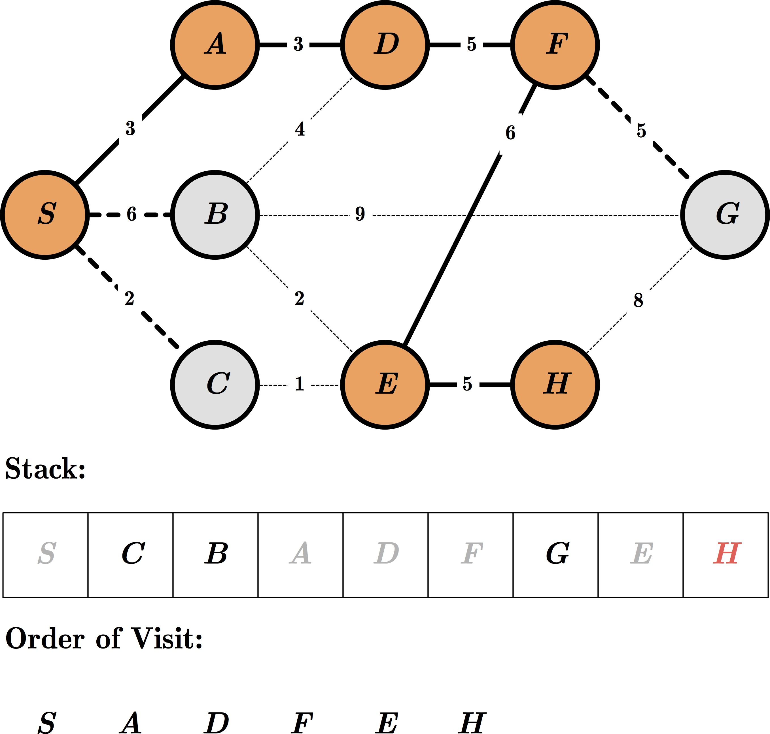
Exercise: DFS

Slide 69
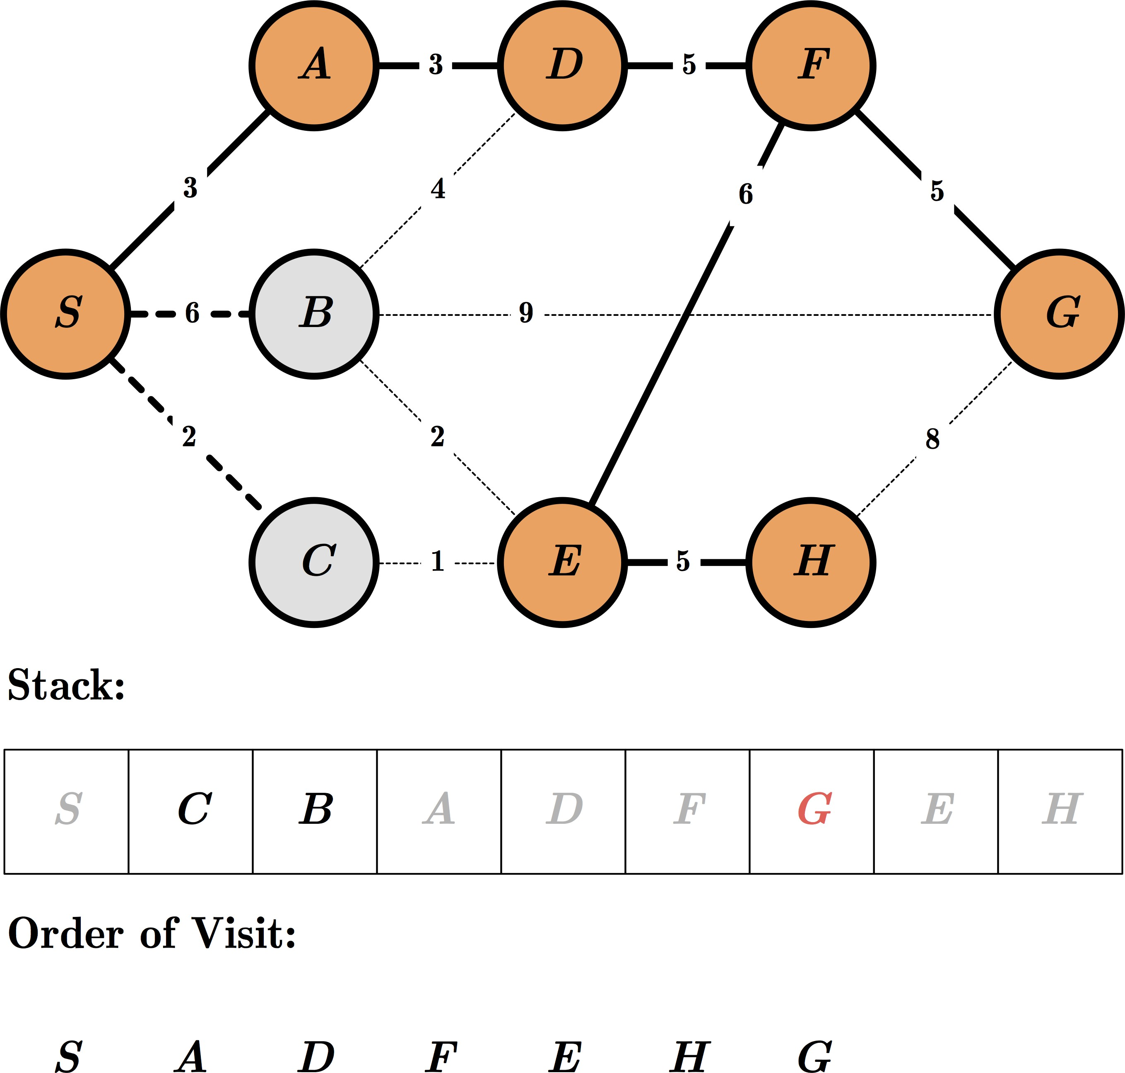
Exercise: DFS

Slide 70
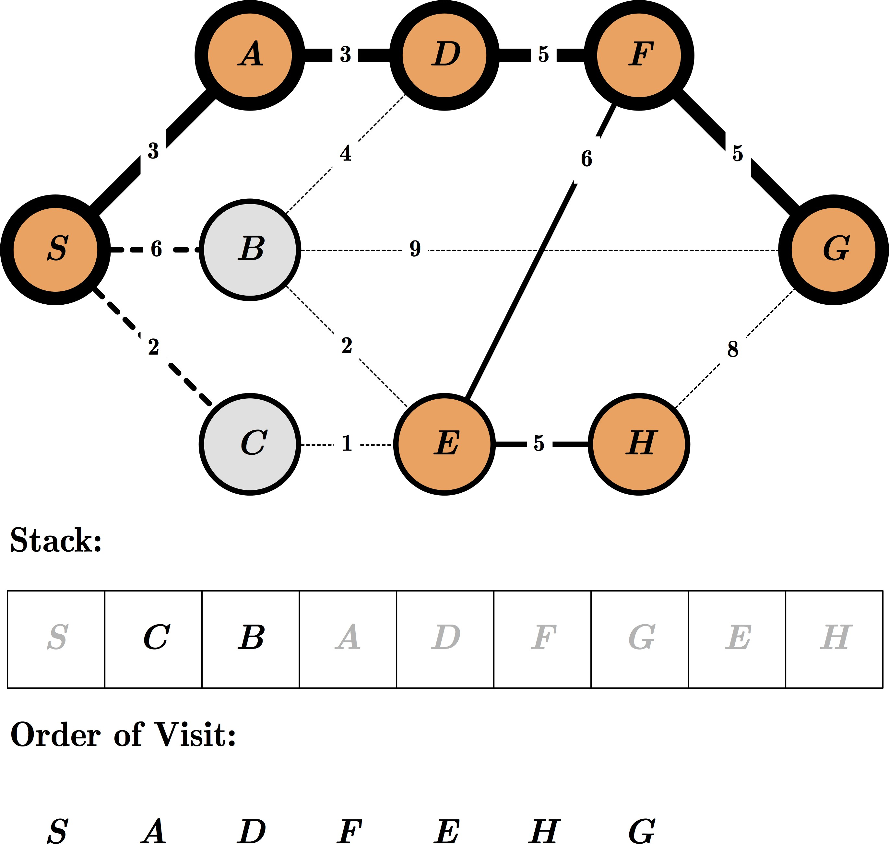
Exercise: DFS

Slide 72
Bidirectional Search
Bidirectional search is a graph search algorithm that finds a shortest path from an initial start state to a goal state in a directed graph. It runs two simultaneous searches: one forward from the initial state, and one backward from the goal, stopping when the two meet.
The reason for this approach is that in many cases it is faster: for instance, in a simplified model of search problem complexity in which both searches expand a tree with branching factor b, and the distance from start to goal is d, each of the two searches has complexity O(b^{d/2}) (in Big O notation), and the sum of these two search times is much less than the O(b^{d}) complexity that would result from a single search from the beginning to the goal.

Slide 73
Complexity of Basic Search Algorithms
For simpler analysis consider state-space as a tree
Uniform branching b
Solution at depth d
d
Number of nodes at level d : b^{d}

Slide 74
Bidirectional Search
Complexity of Bidirectional Search
Consider the following case:
- forward and backward branching both b, uniform ..
d
d/2
d/2
Time ~ b^{d/2}
_{+ b}d/2
< b^{d}

Slide 75
Repeated States
No
Few
Many
1 | 2 | 3
 | 5
7 | 8 | 6
search tree is finite
search tree is infinite
4
8-queens
assembly planning
8-puzzle and robot navigation

Slide 76
Avoiding Repeated States
Requires comparing state descriptions.
For example, Breadth-first strategy:
Keep track of all generated states.
If the state of a new node already exists, then discard the node.

Slide 77
Avoiding Repeated States
Depth-first strategy:
Solution 1:
Keep track of all states associated with nodes in current path
If the state of a new node already exists, then
discard the node
Solution 2:
Keep track of all states generated so far
If the state of a new node has already been generated, then discard the node

Slide 78
Uniform-Cost Strategy
Each step has some cost ≥ ε > 0.
The cost of the path to each fringe node N is
g(N) = Σ costs of all steps.
The goal is to generate a solution path of minimal cost.
The queue FRINGE is sorted in increasing cost.
A
S
0
1
10
S
5
B
5
G
A
B
C
1
5
15
5
15
C
G
G
Nodes List = (S0)
Nodes List = (A1, B5, C15) Nodes List = (B5, G11, C15) Nodes List = (G10, G11, C15)
11
10

Slide 79
Uniform-Cost Strategy
Each step has some cost ≥ ε > 0.
The cost of the path to each fringe node N is
g(N) = Σ costs of all steps.
The goal is to generate a solution path of minimal cost.
The queue FRINGE is sorted in increasing cost.
A
S
0
1
10
S
5
B
5
G
A
B
C
1
5
15
5
15
C
G
G
Nodes List = (S0)
Nodes List = (A1, B5, C15) Nodes List = (B5, G11, C15) Nodes List = (G10, G11, C15)
11
10

Slide 80

Informed Search
[ Heuristic Search ]

Slide 81
Best-First Search
Define a function:
f : node N → real number f(N)
called the evaluation function, whose value depends on the contents of the state associated with N.
Order the nodes in the fringe in increasing values of f(N).
f(N) can be any function you want, but will it work?

Slide 82
Heuristic Function
Function h(N) that estimate the cost of the cheapest path
from node N to goal node.
Example: 8-puzzle
5 |  | 8
4 | 2 | 1
7 | 3 | 6
1 | 2 | 3
4 | 5 | 6
7 | 8
h(N) = number of misplaced tiles
= 6
N
goal

Slide 83
Heuristic Function
Function h(N) that estimate the cost of the cheapest path
from node N to goal node.
Example: 8-puzzle
5 |  | 8
4 | 2 | 1
7 | 3 | 6
1 | 2 | 3
4 | 5 | 6
7 | 8
h(N) = sum of the distances of every tile to its goal position
= 2 + 3 + 0 + 1 + 3 + 0 + 3 + 1
= 13
N
goal

Slide 84



Robot Navigation
 |  |  |  |  |  |  |  |  |  |  |  |  |  |  | N
Y_{N}
X_{N}
h(N) = Straight-line distance to the goal
= [(X_{g} – X_{N})² + (Y_{g} – Y_{N})²]^{1/2}

Slide 85
Examples of Evaluation function
Let g(N) be the cost of the best path found so far between the initial node and N
f(N) = h(N) → greedy best-first f(N) = g(N) + h(N)

Slide 86















8-Puzzle
f(N) = h(N) = number of misplaced tiles
3
3
4
5
3
4
2
4
2
1
3
3
0
4
5
4

Slide 87

8-Puzzle
f(N) = g(N) + h(N)
with h(N) = number of misplaced tiles
3+3
1+5
2+3
3+4
5+2
0+4
3+2
4+1
1+3
2+3
5+0
3+4
1+5
2+4

Slide 88


8-Puzzle
f(N) = h(N) = Σ distances of tiles to goal
6
5
2
5
2
1
4
3
0
4
6
5

Slide 89
More on Heuristic Search & Functions
Symmetry Reduction
X
 | X
 | x
X | O |  | X |  | O | X |  |  |  | X |  |  | X |  |  | O |  |  |  |  | O |  |  | O | X |  |  | X |  |  | X |  |  | X |  |  |  | X
 |  |  |  |  |  |  |  | O |  |  |  |  |  | O |  |  | X |  |  |  | X |  |  |  |  |  | O |  |  |  |  |  |  |  |  |  |  | O
 |  |  |  |  |  |  |  |  |  |  |  | O |  |  |  |  |  |  |  |  |  |  |  |  |  |  |  |  |  | O |  |  |  | O

Slide 90



















More on Heuristic Search & Functions
Heuristic Reduction
X
X
 | X
x
3
2
4
O
 | X
 | O
 | X
O
X | X
O |  | O
 | X
X
O
 | X
 | X
O
 | X
 |  | X
 | O
 | X
X
 | O
X | X
 | O
 | X
 | X
X | O
 | X
3
4
4
5
5
4
4
3

Slide 91
More on Heuristic Search & Functions Hill Climbing Strategy
“Method of blind mountain climbers to go uphill along the
steepest possible path until no farther to go”
Expand to the current state and evaluate its children. The best child is selected for further expansion until reaching a state that is better than any of its children.
It fails to find a solution in case of the reaching state is not a goal but just a local maximum state.
The strategy can be used effectively if the evaluation function if sufficiently informative to distinguish between local and global maximum.

Slide 92
More on Heuristic Search & Functions Best-First Search
Use open list to keep track of the current edge of the
search and closed list to record states already visited.
Order the states on open list according to some heuristic estimate of their closeness to a goal and the most promising state is considered in each iteration.
The best state to be examined in each iteration may be
from any level of the state space.
Open sorted list is represented as a priority queue.

Slide 93
More on Heuristic Search & Functions 8-Puzzle Heuristics
 | 5 | 6 | 0
 | 3 | 4 | 0
 | 5 | 6 | 0
 | Tiles out of place | Sum of distance of place | 2x the number of direct tile reversals
2 | 8 | 3
1 | 6 | 4
 | 7 | 5
2 | 8 | 3
1 |  | 4
7 | 6 | 5
2 | 8 | 3
1 | 6 | 4
7 |  | 5
1 | 2 | 3
8 |  | 4
7 | 6 | 5
2 | 8 | 3
1 | 6 | 4
7 | 5
Goal

Slide 94
More on Heuristic Search & Functions 8-Puzzle Heuristics
g(n)=0 g(n)=1 g(n)=2 g(n)=3 g(n)=4
g(n)=5
2 | 8 | 3
1 | 6 | 4
 | 7 | 5
2 | 8 | 3
 | 1 | 4
7 | 6 | 5
f(b)=6
f(e)=5
2 | 8 | 3
1 |  | 4
7 | 6 | 5
2 |  | 3
1 | 8 | 4
7 | 6 | 5
1 | 2 | 3
8 |  | 4
7 | 6 | 5
2 | 8 | 3
1 | 6 | 4
7 |  | 5
f(c)=4
f(f)=5
Goal
Start
f(a)=4
2 | 8 | 3
1 | 6 | 4
7 | 5
2 | 8 | 3
1 | 4
7 | 6 | 5
f(n)= h(n) + g(n)
f(d)=6
f(g)=6

Slide 95
Thanks! … Questions?

